Slide 1
Chapter 8
Data Privacy

Slide 2
Data Collection
IP addresses
Visited urls
Anonymized? If so, supposed to prevent personal identification
Europe considers IP address personal information

Slide 3
ISP Subscriber Information
Links IP address to individual subscriber
Info may be needed for litigation/prosecution
Balance anonymous free speech with opponents reputation
Courts rule both ways…

Slide 4
Search Engine Queries
Retain lots of info
Search string, date, time, IP address…
May store cookie that can track subsequent searches
Imagine if Joe McCarthy had access to this data in the 1950’s!
Bush administration trying to obtain search engine records…scary…

Slide 5
Data Retention
Deleting ISP log files permissible but
Electronic Communication Transactional Records Act of 1996 requires ISP to retain records for 90 days upon request of government entity
Bush administration wanted to go further…
SAFETY bill, retain records FOREVER!
Mark Foley sponsor, how ironic

Slide 6
EU Data Retention
Retention policies of 6 months to 2 years (country dependent)
UK had issue with FaceBook not deleting photos, only unlinking
Problem-longer data retention policy increases risk of data being stolen or misused
No standard yet

Slide 7
Data Breach
Most businesses take inadequate security measures
Most hackers use state of the art technology
Best defense-encrypt data-while in transit and in storage

Slide 8
Data Breach Types
Intrusion
Accidental Disclosure
Insider Breach
Portable Device Breech
Stationary Device Breech
Hard Copy Loss
Payment Card Fraud

Slide 9
Data Breach Consequences
ARRA-American Recovery and Reinvestment Act
HITECH-Health Information Technology for Economic and Clinical Health
HIPAA-Health Insurance Portability and Accountability Act

Slide 10
Data Breach Consequences
Electronic medical record breach(es) can be devastating
Courts revisiting whether consumers have standing to sue corporations suffering data breaches-class action lawsuits?

Slide 11
Metadata
Metadata-data about data
Background at GRC.com (Metadata)
Typically created in conjunction with computer files-text documents (next slide)
Discoverable and could be valuable to an opposing party
Federal Rules of Civil Procedure
Consider stripping metadata from files
Be mindful of any litigation holds

Slide 12
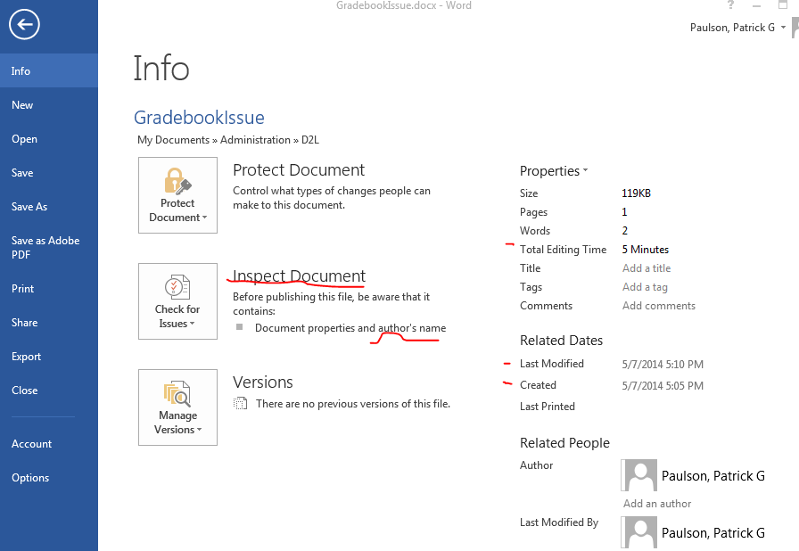
Metadata Example-Word Doc

Slide 13
Data in the Wrong Hands
Consider who else may have access to an email account
People share accounts, passwords
Committees share accounts (fdc@winona.edu)
Wire Shark - http://www.wireshark.org/
A network protocol analyzer that lets you see what is happening on your network at a microscopic level.

Slide 14
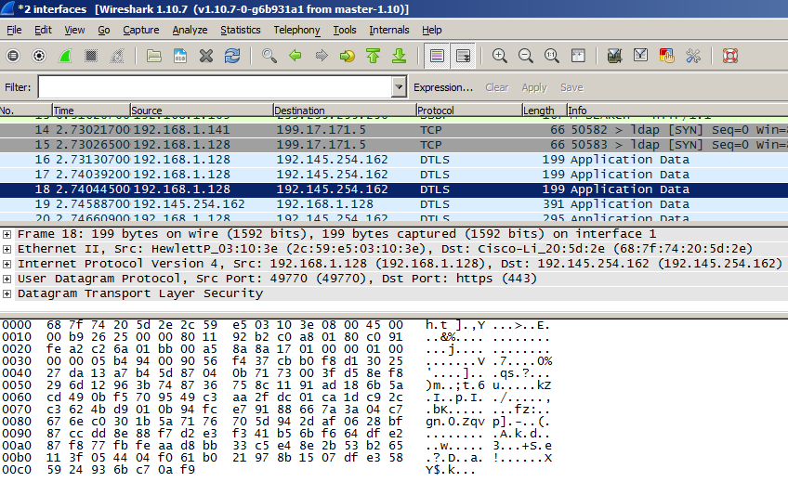
Public Wi-Fi and WireShark

Slide 15
Data in the Wrong Hands
Cloud computing
Controlled by Policies and Procedures
Who has physical access?
Post termination conditions?
Effect of third-party subpoena
Where is the data, physically?
Other electronic devices
Camera memory cards
Fax machines, copiers
Smartphones

Slide 16
Public Records
Pre internet
Almost inaccessible
Post internet
Easily accessible
Egalitarian?
Governments beginning to post online
Employer background checks
Data validity?

Slide 17
Information Broker Liability
Used to be private investigator
Now collate public info
Liability if info used by stalker?
Boyer/Youens-yes

Slide 18
Insurer Liability
Not clear what circumstances insurer liable for dissemination of third party info
Indemnity issues, so may be specific riders in future

