Slide 1
Assignment 3 Querying and Maintaining a Database

Slide 2
Objectives
Find, modify, and delete records in a table
Use the Query window in Design view
Create, run, and save queries
Update data using a query datasheet
Create a query based on multiple tables
Sort data in a query
Filter data in a query

Slide 3
Objectives
Specify an exact match condition in a query
Change the font size and alternate row color in a datasheet
Use a comparison operator in a query to match a range of values
Use the And and Or logical operators in queries
Create and format a calculated field in a query
Perform calculations in a query using aggregate functions and record group calculations
Change the display of database objects in the Navigation Pane

Slide 4
Query by Design View

Slide 5
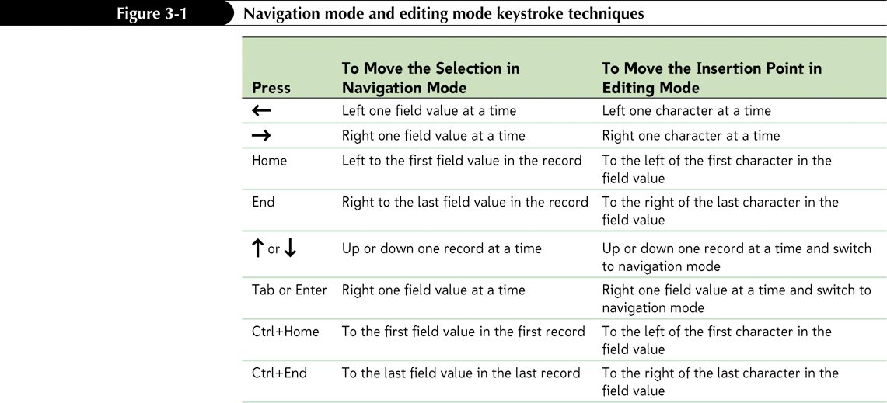
Updating a Database
Updating, or maintaining, a database is the process of adding, modifying, and deleting records in database tables to keep them current and accurate
Navigation mode
Editing mode

Slide 6
Finding Data in a Table
The Find command allows you to search a table or query datasheet, or a form, to locate a specific field value or part of a field value

Slide 7
Deleting a Record
With the table open in Datasheet view, click the row selector for the record you want to delete
In the Records group on the Home tab, click the Delete button (or right-click the row selector for the record, and then click Delete Record on the shortcut menu)
In the dialog box asking you to confirm the deletion, click the Yes button

Slide 8
Deleting a Record

Slide 9
Introduction to Queries
Access provides powerful query capabilities that allow you to do the following:
Display selected fields and records from a table
Sort records
Perform calculations
Generate data for forms, reports, and other queries
Update data in the tables in a database
Find and display data from two or more tables
A Query Wizard uses guided questions to set properties, then creates a query based. May need to be further modified

Slide 10
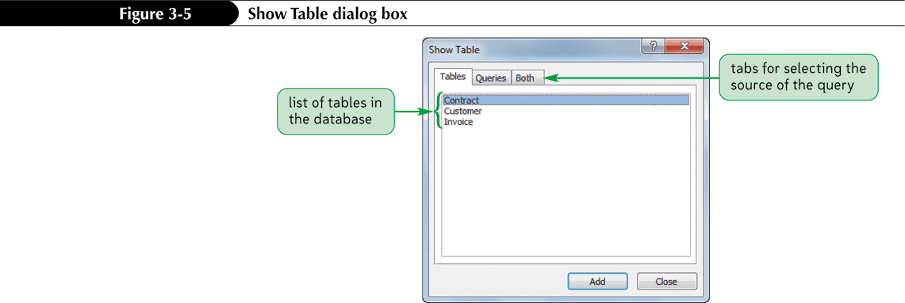
Introduction to Queries
Click the Create tab on the Ribbon
In the Other group on the Create tab, click the Query Design button

Slide 11
Introduction to Queries

Slide 12
Updating Data Using a Query
You can update the data in a table using a query datasheet
After updating the query, close the table

Slide 13
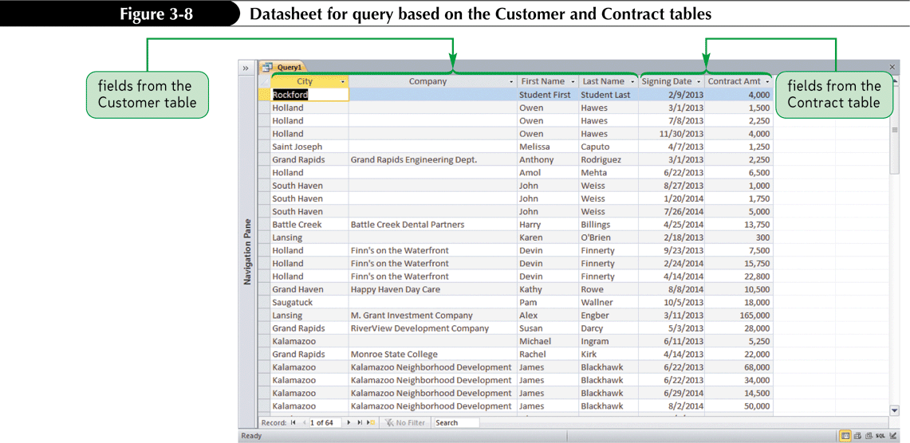
Creating a Multitable Query
A multitable query is a query based on more than one table
If you want to create a query that retrieves data from multiple tables, the tables must have a common field

Slide 14
Sorting Data in a Query
Sorting is the process of rearranging records in a specified order or sequence
To sort records, you must select the sort field, which is the field used to determine the order of records in the datasheet

Slide 15
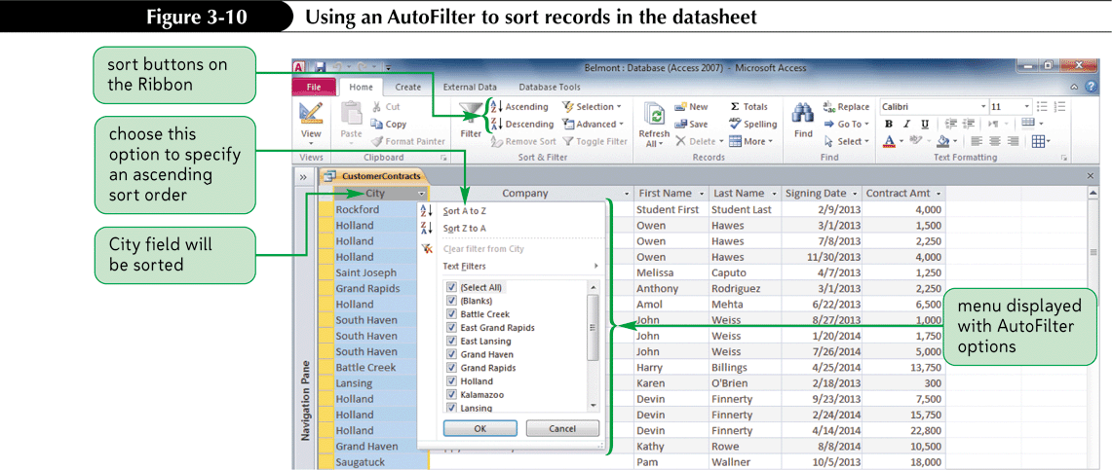
Using an AutoFilter to Sort Data
The AutoFilter feature enables you to quickly sort and display field values in various ways
Clicking the arrow in a column heading displays the AutoFilter menu

Slide 16
Sorting a Query Datasheet
In the query datasheet, click the arrow on the column heading for the field you want to sort
In the menu that opens, click Sort A to Z for an ascending sort, or click Sort Z to A for a descending sort
or
In the query datasheet, select the column or adjacent columns on which you want to sort
In the Sort & Filter group on the Home tab, click the Ascending button or the Descending button
or
In Design view, position the fields serving as sort fields from left to right
Click the right side of the Sort box for the field you want to sort, and then click Ascending or Descending for the sort order

Slide 17
Sorting a Query Datasheet

Slide 18
Using Filter By Selection
A filter is a set of restrictions you place on the records in an open datasheet or form to temporarily isolate a subset of the records
In the datasheet or form, select part of the field value that will be the basis for the filter; or, if the filter will be based on the entire field value, click anywhere within the field value
In the Sort & Filter group on the Home tab, click the Selection button, and then click the type of filter you want to apply

Slide 19
Using Filter By Selection

Slide 20
Selection Criteria in Queries

Slide 21
Defining Record Selection Criteria for Queries
Just as you can display selected fields from a database in a query datasheet, you can display selected records
To tell Access which records you want to select, you must specify a condition as part of the query
A condition usually includes a comparison operator

Slide 22
Defining Record Selection Criteria for Queries

Slide 23
Specifying an Exact Match
With an exact match, the value in the specified field must match the condition exactly in order for the record to be included in the query results

Slide 24
Changing a Datasheet’s Appearance
You can change the characteristics of a datasheet, including the font type and size of text in the datasheet, to improve its appearance or readability
A theme is a predefined set of formats including colors, fonts, and other effects that enhance an object’s appearance and usability

Slide 25
Changing a Datasheet’s Appearance

Slide 26
Using a Comparison Operator to Match a Range of Values

Slide 27
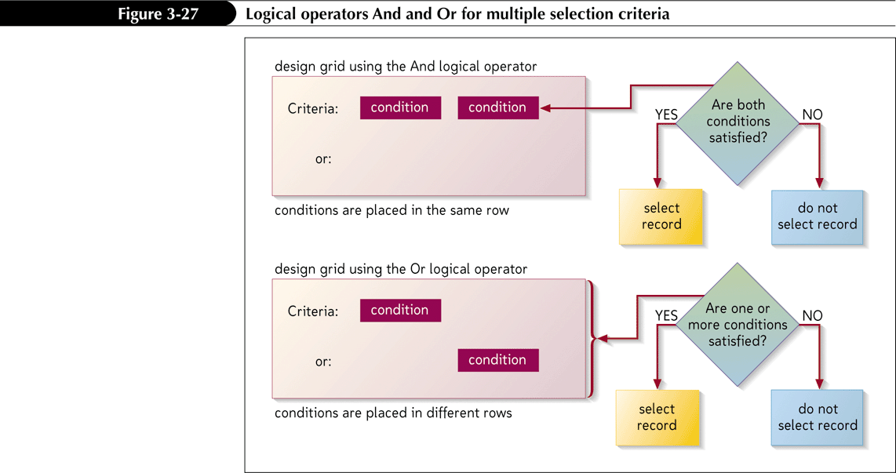
Defining Multiple Selection Criteria for Queries
Multiple conditions require you to use logical operators to combine two or more conditions
Use the And logical operator when you want a record selected only if two or more conditions are met
Use the Or logical operator when you place conditions in different Criteria rows

Slide 28
Defining Multiple Selection Criteria for Queries

Slide 29
Creating a Calculated Field
Create query to perform calculations, instead of storing data
Calculation consists of an expression containing a combination of database fields, constants, and operators
Expression Builder is an Access tool that makes it easy for you to create an expression
Open the query in Design view
In the design grid, click the Field box in which you want to create an expression
In the Query Setup group on the Design tab, click the Builder button
Use the expression elements and common operators to build the expression, or type the expression directly in the expression box
Click the OK button

Slide 30
Creating a Calculated Field

Slide 31
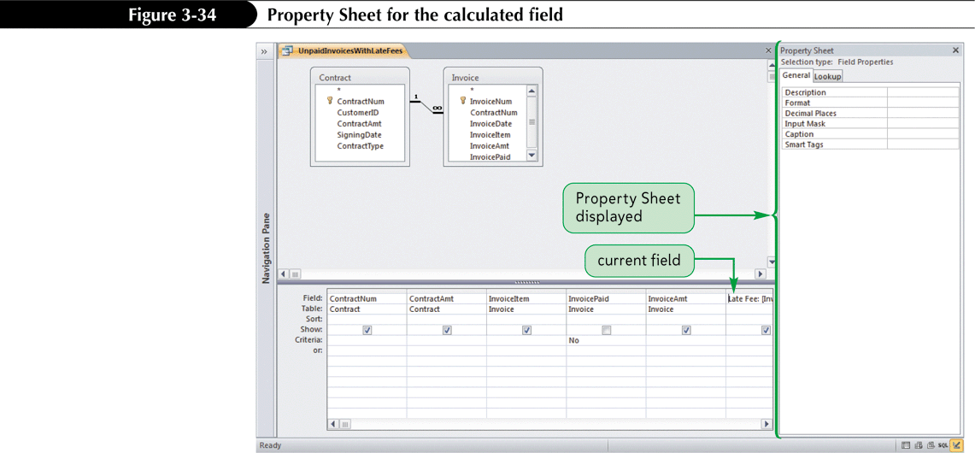
Formatting a Calculated Field
Can specify a particular format for a calculated field by modifying its properties

Slide 32
Using Aggregate Functions
Aggregate functions perform arithmetic operations on selected records in a database
To quickly perform a calculation using an aggregate function in a table or query datasheet, use the Totals button in the Records group on the Home tab

Slide 33
Using Aggregate Functions

Slide 34
Creating Queries with Aggregate Functions
Aggregate functions operate on the records that meet a query’s selection criteria

Slide 35
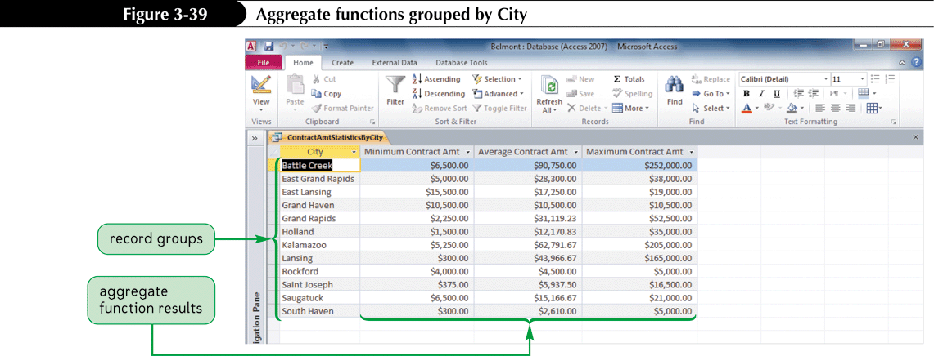
Using Record Group Calculations
The Group By operator divides the selected records into groups based on the values in the specified field

Slide 36
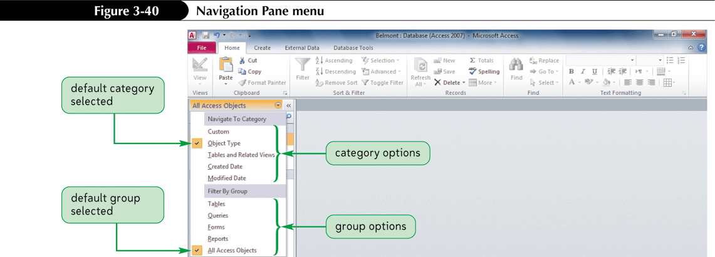
Working with the Navigation Pane
The Navigation Pane is the main area for working with the objects in a database
The Navigation Pane divides database objects into categories, and each category contains groups
Object Type
All Access Objects

