Slide 1
Tutorial 4 Creating Forms and Reports

Slide 2
Objectives
Create a form using the Form Wizard
Apply a theme to a form
Add a picture to a form
Change the color and line type of items on a form
Find and maintain data using a form
Preview and print selected form records

Slide 3
Objectives
Create a form with a main form and a subform
Create a report using the Report Wizard
Apply a theme to a report
Resize fields in a report
Insert a picture in a report
Use conditional formatting in a report
Preview and print a report

Slide 4
Form Displayed in Form View

Slide 5
Creating a Form Using the Form Wizard
The Form Wizard provides choices for some or all of the fields in the selected table or query, fields from other tables and queries, and display the selected fields in any order on the form
Click the Create tab in the Ribbon
In the Forms group, click the Form Wizard button

Slide 6
Creating a Form Using the Form Wizard

Slide 7
Creating a Form Using the Form Wizard

Slide 8
Applying a Theme to a Form
Display the form in Layout view
In the Themes group on the Design tab, click the Themes button
In the displayed gallery, click the theme to apply to all objects; or, right-click the theme to display the shortcut menu, and then choose to apply the theme to the current object only or to all matching objects

Slide 9
Adding a Picture to a Form
A picture is one of many controls you can add and modify on a form
A control is an item on a form, report, or other database object that you can manipulate to modify the object’s appearance
In the Header/Footer group on the Design tab, click the Logo button
Navigate to the picture and then click the OK button

Slide 10
Adding a Picture to a Form

Slide 11
Changing the Color of the Form Title
The Font group on the Format tab provides options to change the appearance of text

Slide 12
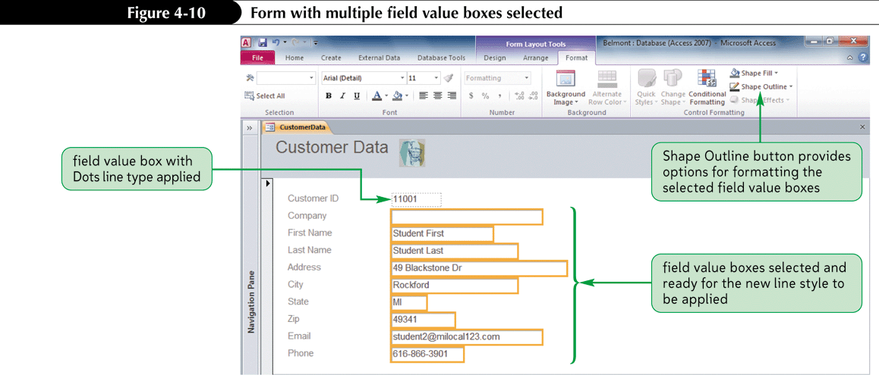
Changing the Type of Line on a Form
A line on a form, such as the box around each field value, is another type of control that can be modified in Layout view

Slide 13
Finding Data in a Form or Datasheet
Open the form or datasheet, then select the field to search
In the Find group on the Home tab, click the Find button to open the Find and Replace dialog box
In the Find What box, type the field value being sought
Complete the remaining options, as necessary, to specify the type of search to conduct
Click the Find Next button to begin the search
Click the Find Next button to continue searching for the next match
Click the Cancel button to stop the search operation

Slide 14
Finding Data in a Form or Datasheet

Slide 15
Finding Data in a Form or Datasheet

Slide 16
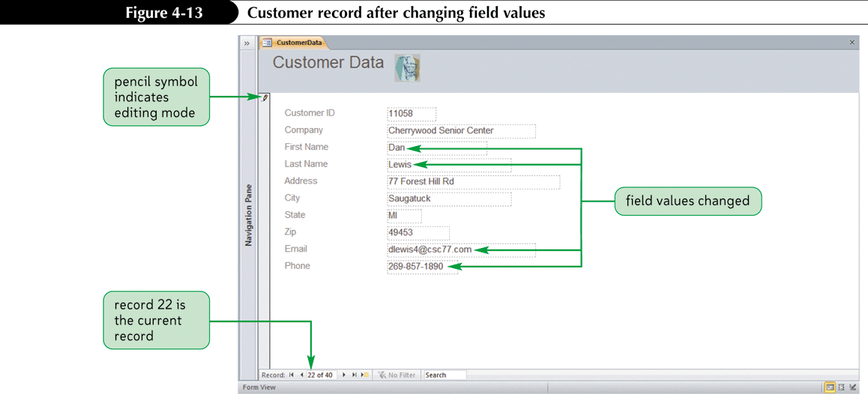
Maintaining Table Data Using a Form
Maintaining data using a form is often easier than using a datasheet, because the focus is on a single record

Slide 17
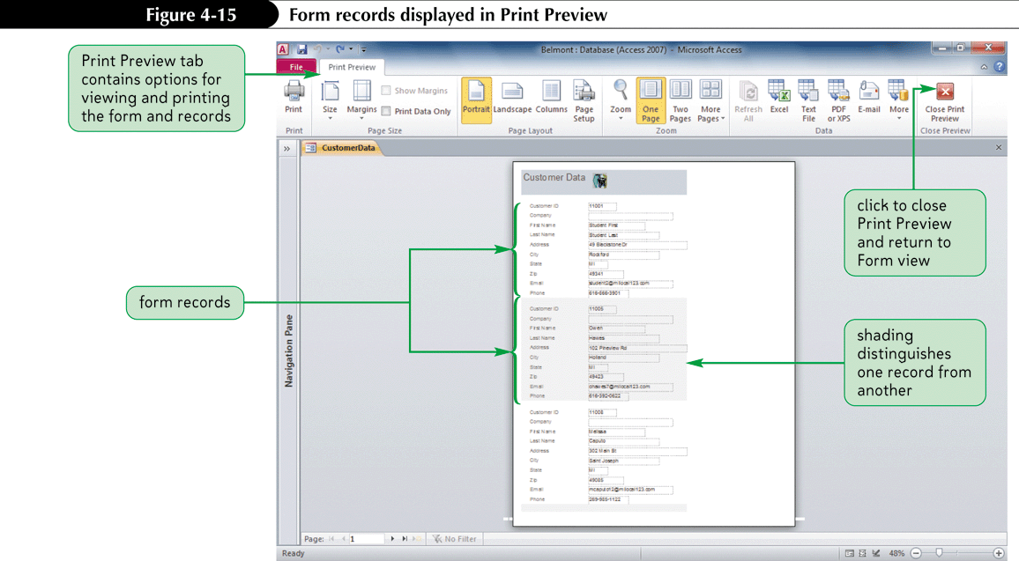
Previewing and Printing Selected Form Records
Access prints as many form records as can fit on a printed page

Slide 18
Report in Print Preview

Slide 19
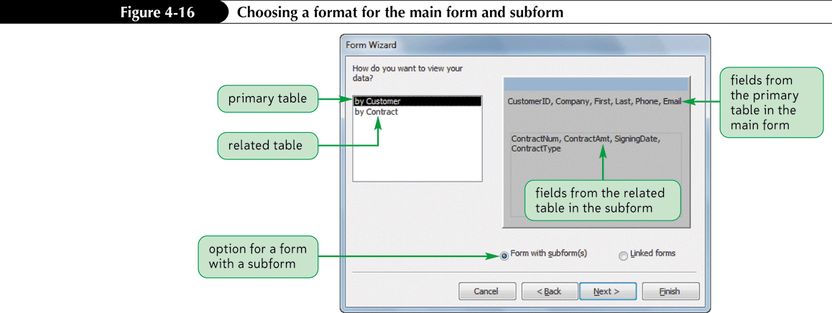
Creating a Form with a Main Form and a Subform
When creating a form containing data from two tables with a one-to-many relationship, a main form for data from the primary table and a subform for data from the related table are created

Slide 20
Creating a Form with a Main Form and a Subform
Provides compact view of related data

Slide 21
Creating a Report Using the Report Wizard
The Report Wizard provides choices, then creates a report based on responses
A report is a formatted printout of the contents of one or more tables or queries in a database
Modify report’s design after wizard is finished

Slide 22
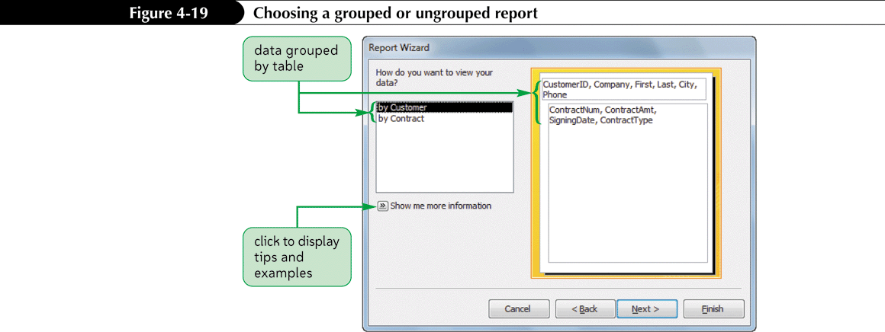
Creating a Report Using the Report Wizard
Click the Create tab on the Ribbon
In the Reports group on the Create tab, click the Report Wizard button

Slide 23
Creating a Report Using the Report Wizard

Slide 24
Creating a Report Using the Report Wizard

Slide 25
Creating a Report Using the Report Wizard

Slide 26
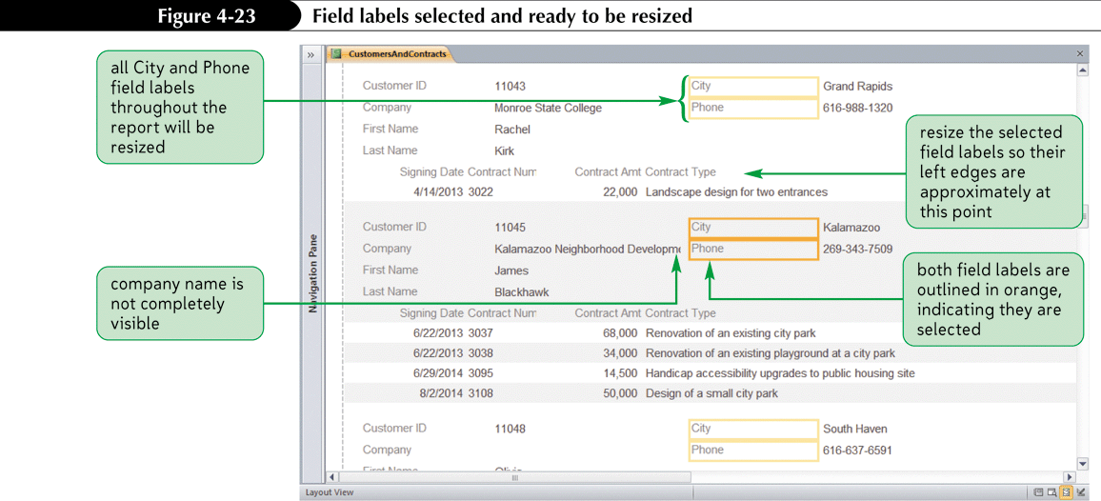
Modifying a Report’s Design in Layout View
Click the Layout View button on the status bar

Slide 27
Modifying a Report’s Design in Layout View

Slide 28
Using Conditional Formatting in a Report
Conditional formatting in a report (or form) is special formatting applied to certain field values depending on one or more conditions
Click the appropriate field value
In the Control Formatting group on the Format tab, click the Conditional Formatting button
Click the New Rule button

Slide 29
Using Conditional Formatting in a Report

Slide 30
Using Conditional Formatting in a Report

