Slide 1
Tutorial 5 Advanced Queries and Enhanced Table Design

Slide 2
Objectives
Review table and object naming standards
Use the Like, In, Not, and & operators in queries
Filter data using an AutoFilter
Use the IIf function to assign a conditional value to a calculated field in a query
Create a parameter query

Slide 3
Objectives
Use query wizards to create a crosstab query, a find duplicates query, and a find unmatched query
Create a top values query
Modify table designs using lookup fields, input masks, and data validation rules
Identify object dependencies
Review a Memo field’s properties
Designate a trusted folder

Slide 4
Database Naming Conventions

Slide 5
Using a Pattern Match in a Query
A pattern match selects records with a value for the designated field that matches the pattern of the simple condition value
The Like comparison operator selects records by matching field values to a specific pattern that includes one or more of these wildcard characters: asterisk (*), question mark (?), and number symbol (#)

Slide 6
Using a List-of-Values Match in a Query
A list-of-values match selects records whose value for the designated field matches one of two or more simple condition values
The In comparison operator lets you define a condition with a list of two or more values for a field

Slide 7
Using the Not Logical Operator in a Query
The Not logical operator negates a criterion or selects records for which the designated field does not match the criterion

Slide 8
Using an AutoFilter to Filter Data

Slide 9
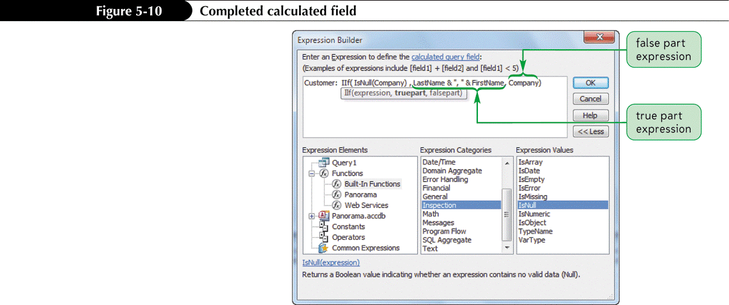
Assigning a Conditional Value to a Calculated Field
The & (ampersand) operator is a concatenation operator that joins text expressions
The IIf (Immediate If) function assigns one value to a calculated field or control if a condition is true, or a second value if the condition is false
The IsNull function tests a field value or an expression for a null value; if the field value or expression is null, the result is true; otherwise, the result is false

Slide 10
Creating a Parameter Query
A parameter query displays a dialog box that prompts the user to enter criteria when the query is run
In Design View, create a select query that includes all fields to appear in the query results. Choose the sort fields and set other field criteria that will not change
For fields which will change when the query runs, type a ‘prompt’ in the criteria box, enclosed in square brackets [prompt goes here]
Saves time by creating one query that replaces many

Slide 11
Creating a Parameter Query

Slide 12
Creating a Crosstab Query

Slide 13
Creating a Crosstab Query
A crosstab query uses aggregate functions to perform arithmetic operations on selected records

Slide 14
Creating a Crosstab Query
In the Queries group on the Create tab, click the Query Wizard button
In the New Query dialog box, click Crosstab Query Wizard, and then click the OK button
Complete the Wizard dialog boxes to select the table or query on which to base the crosstab query, select the row heading field (or fields), select the column heading field, select the calculation field and its aggregate function, and enter a name for the crosstab query

Slide 15
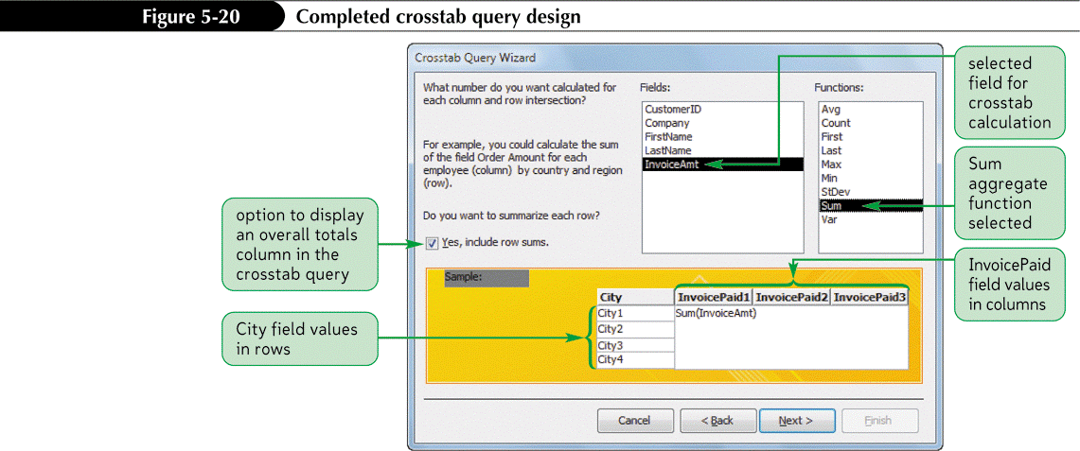
Creating a Crosstab Query

Slide 16
Running a Crosstab Query

Slide 17
Creating a Find Duplicates Query
A find duplicates query is a select query that finds duplicate records in a table or query
In the Queries group on the Create tab, click the Query Wizard button
Click Find Duplicates Query Wizard, and then click the OK button
Complete the Wizard dialog boxes to select the table or query on which to base the query, select the field (or fields) to check for duplicate values, select the additional fields to include in the query results, enter a name for the query, and then click the Finish button

Slide 18
Creating a Find Unmatched Query
A find unmatched query is a select query that finds all records in a table or query that have no related records in a second table or query
In the Queries group on the Create tab, click the Query Wizard button
Click Find Unmatched Query Wizard, and then click the OK button
Complete the Wizard dialog boxes to select the table or query on which to base the new query, select the table or query that contains the related records, specify the common field in each table or query, select the additional fields to include in the query results, enter a name for the query, and then click the Finish button

Slide 19
Creating a Find Unmatched Query

Slide 20
Creating a Top Values Query
The Top Values property for a query limits the number of records returned in the query results
Create a select query with the necessary fields and sorting and selection criteria
In the Query Setup group on the Design tab, enter the number or percentage of records desired in the Return (Top Values) text box

Slide 21
Creating a Top Values Query

Slide 22
Lookup Fields and Input Masks

Slide 23
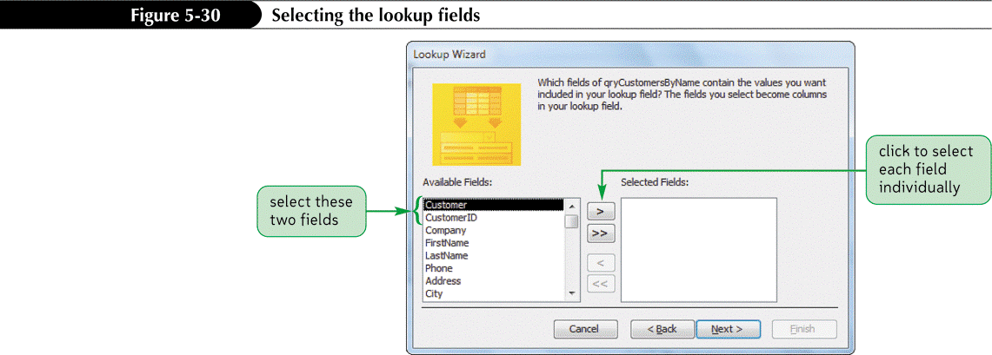
Creating a Lookup Field
A lookup field lets the user select a value from a list of possible values, limiting choices, eliminating typos and speeding data entry
Use a Lookup Wizard field in Access to create a lookup field in a table

Slide 24
Creating a Lookup Field

Slide 25
Using a Lookup Field

Slide 26
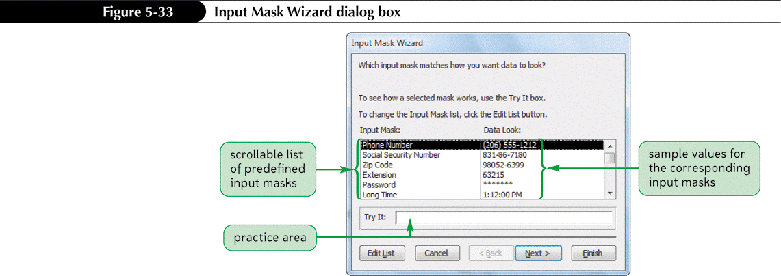
Using the Input Mask Wizard
A literal display character is a special character that automatically appears in specific positions of a field value; users don’t need to type literal display characters
Input mask

Slide 27
Using the Input Mask Wizard

Slide 28
Using the Input Mask Wizard

Slide 29
Identifying Object Dependencies
An object dependency exists between two objects when a change to the properties of data in one object affects the properties of data in the other object
The Object Dependencies pane displays a collapsible list of the dependencies among the objects in an Access database; click the list’s expand indicators to show or hide different levels of dependencies

Slide 30
Identifying Object Dependencies

Slide 31
Defining Data Validation Rules
To prevent a user from entering an incorrect value in a field, create a field validation rule
The Validation Rule property value specifies the valid values that users can enter in a field
The Validation Text property value will be displayed in a dialog box if the user enters an invalid value
A table validation rule compares one field value in a table record to another field value in the same record to verify their relative accuracy

Slide 32
Defining Data Validation Rules

Slide 33
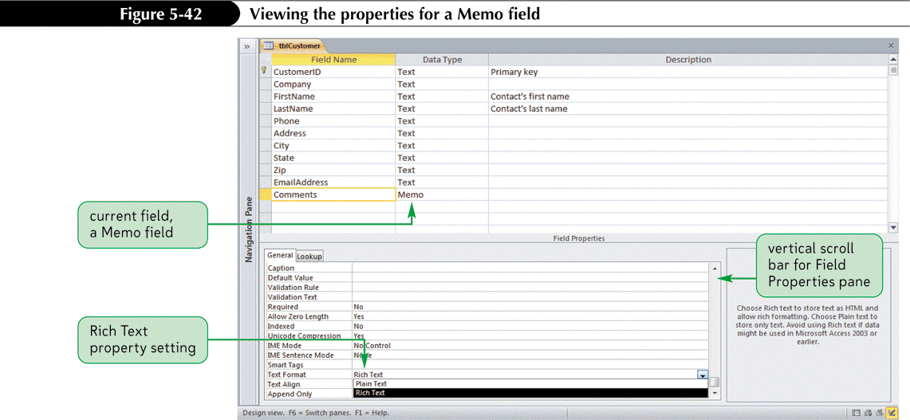
Working with Memo Fields
Use a Memo field for long comments and explanations
Text fields are limited to 255 characters, but Memo fields can hold up to 65,535 characters
Downside-not indexable like a text field

Slide 34
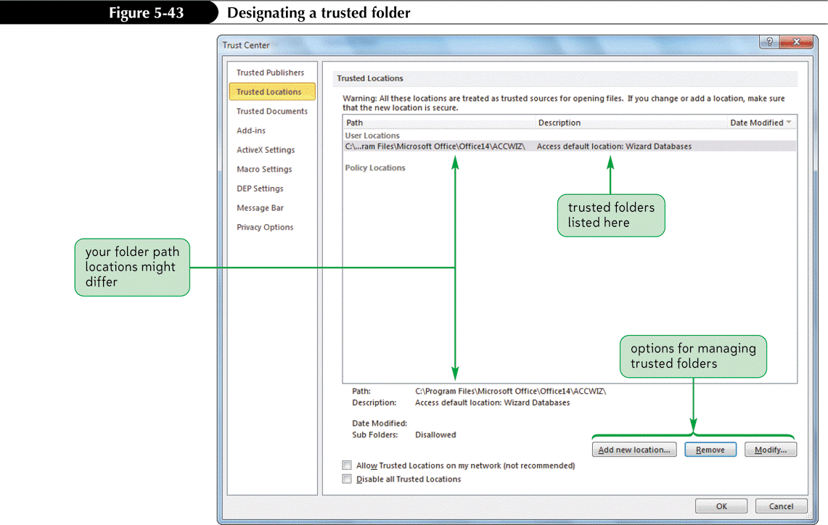
Designating a Trusted Folder
A trusted folder is where known safe databases are placed

