Slide 1
Tutorial 6 Using Form Tools and Creating Custom Forms

Slide 2
Objectives
Change a lookup field to a Text field
View and print database documentation
Create datasheet, multiple items, and split forms
Modify a form and anchor form controls in Layout view
Plan, design, and create a custom form in Design view and in Layout view
Select, move, align, resize, delete, and rename controls in a form

Slide 3
Objectives
Add a combo box to a form
Add form headers and footers to a form
Add a combo box to a form to find records
Add a subform to a form
Add calculated controls to a form and a subform
Change the tab order in a form
Improve the appearance of a form

Slide 4
Anchoring Controls

Slide 5
Designing Forms
To create a custom form, either modify an existing form in Layout view or in Design view, or design and create a form from scratch in Layout view or in Design view
A combo box is a control that provides the features of a text box and a list box; allows either choosing a value from the list or typing an entry

Slide 6
Designing Forms

Slide 7
Using the Documenter
Start Access and open the database you want to document
In the Analyze group on the Database Tools tab, click the Database Documenter button
Select the object(s) you want to document
If necessary, click the Options button to select specific documentation options for the selected object(s), and then click the OK button
Click the OK button, print the documentation, and then close the Object Definition window

Slide 8
Using the Documenter

Slide 9
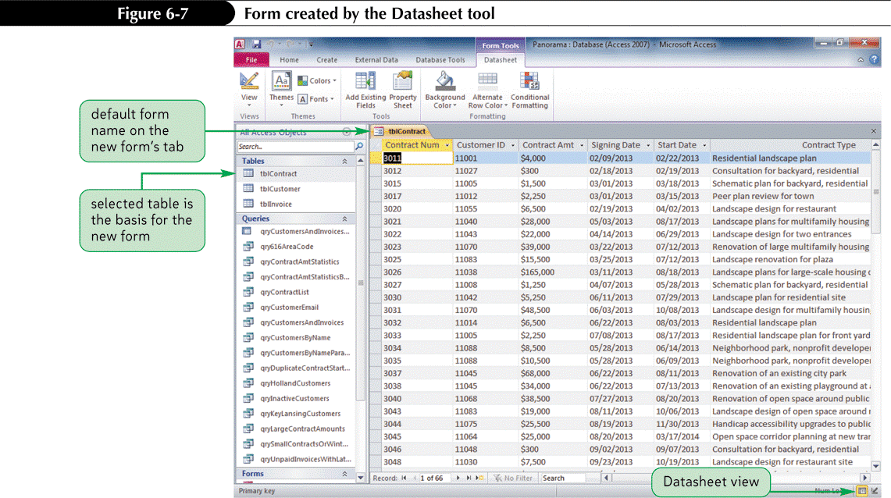
Creating Forms Using Form Tools
The Datasheet tool creates a form in a datasheet format that contains all the fields in the source table or query

Slide 10
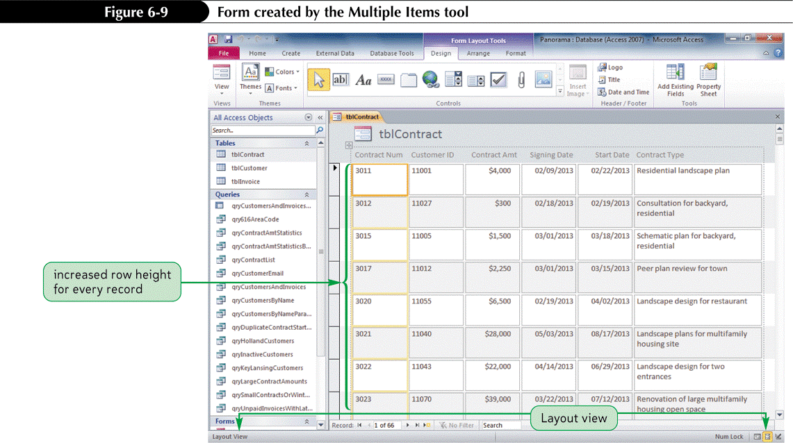
Creating Forms Using Form Tools
The Multiple Items tool creates a customizable form that displays multiple records from a source table or query in a datasheet format

Slide 11
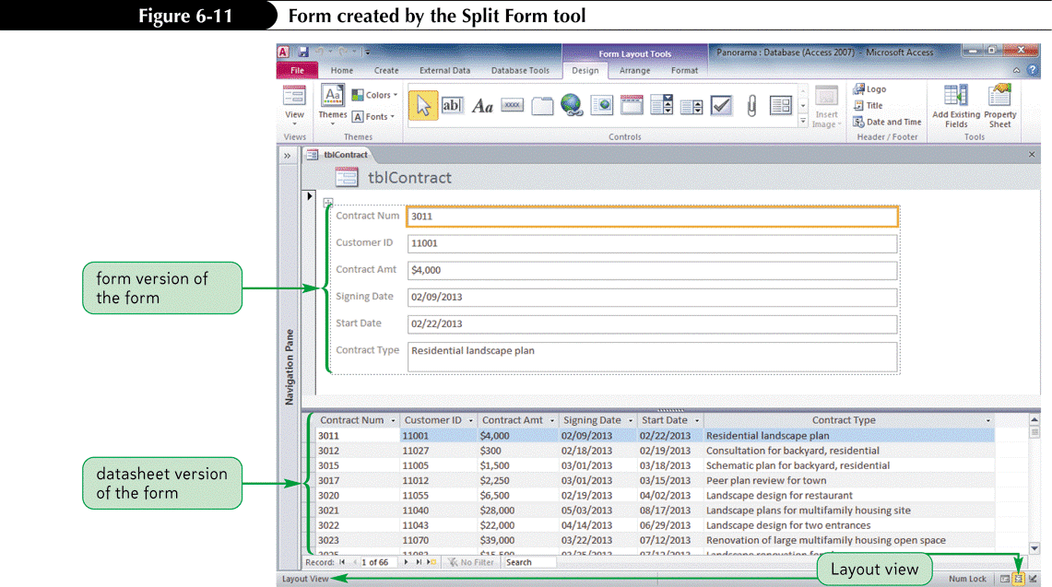
Creating Forms Using Form Tools
The Split Form tool creates a customizable form that displays the data in a form in both Form view and Datasheet view at the same time

Slide 12
Form in Design View

Slide 13
Planning and Designing a Custom Form

Slide 14
Creating a Form in Design View
Click the Create tab on the Ribbon
In the Forms group, click the Blank Form button
Click the Design View button on the status bar
Make sure the Field List pane is open, and then add the required fields to the form
Add other required controls to the form
Modify the size, position, and other properties as necessary for the fields and other controls in the form
Save the form

Slide 15
Creating a Form in Design View

Slide 16
Selecting and Moving Controls
Click the control to select it. To select several controls at once, press and hold down the Shift key while clicking each control. Handles appear around all selected controls
To move a single selected control, drag the control’s move handle, which is the handle in the upper-left corner, to its new position
To move a group of selected controls, point to any selected control until the pointer changes to a move pointer, and then drag the group of selected controls to its new position
To move selected controls in small increments, press the appropriate arrow key
To move selected controls to the next nearest grid dot, hold down the Ctrl key and press the appropriate arrow key

Slide 17
Selecting and Moving Controls

Slide 18
Resizing a Control in Design View
Click the control to select it and display the sizing handles
Place the pointer over the sizing handle you want, and then drag the edge of the control until it is the size you want
To resize selected controls in small increments, hold down the Shift key and press the appropriate arrow key. This technique applies the resizing to the right edge and the bottom edge of the control

Slide 19
Resizing a Control

Slide 20
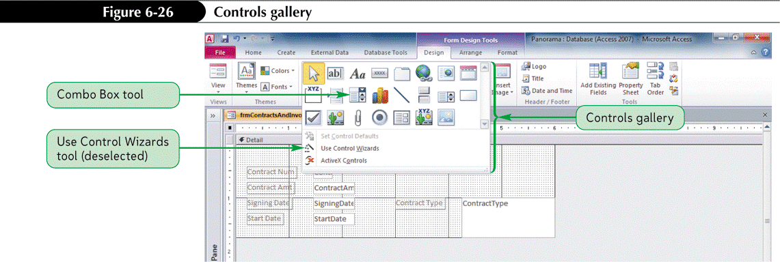
Adding a Combo Box to a Form
Use the Combo Box tool in Design view to add a combo box to a form
A Control Wizard asks a series of questions and then uses answers to create a control in a form or report. Properties can be modified later.

Slide 21
Changing a Label’s Caption
Right-click the label to select it and to display the shortcut menu, and then click Properties to display the property sheet
If necessary, click the All tab to display the All page in the property sheet
Edit the existing text in the Caption box; or click the Caption box and press the F2 key to select the current value, and then type a new caption
In the Tools group on the Design tab, click the Property Sheet button to close the property sheet

Slide 22
Changing a Label’s Caption

Slide 23
Adding and Removing Form Header and Form Footer Sections
In Design view, right-click the Detail section selector, and then click Form Header/Footer on the shortcut menu
or
In Layout view or Design view, click a button in the Header/Footer group on the Design tab to add a logo, title, or date and time to the form
To remove a Form Header or Form Footer section, drag its bottom edge up until the section area disappears or set the section’s Visible property to No

Slide 24
Adding and Removing Form Header and Form Footer Sections

Slide 25
Custom Form in Form View

Slide 26
Using a Combo Box to Find Records
Open the form property sheet in Design view, ensure the record source is a table or query, then close the property sheet
In the Controls group on the Design tab, click the More button, click the Combo Box tool, and then click the position in the form to place the control
Click the third option button (Find a record on my form based on the value I selected in my combo box) in the first Combo Box Wizard dialog box, and then complete the remaining Combo Box Wizard dialog boxes

Slide 27
Adding a Combo Box to Find Records

Slide 28
Adding a Subform to a Form
Use the Subform/Subreport tool in Design view to add a subform to a form
In the Controls group on the Design tab, click the More button to open the Controls gallery, make sure the Control Wizards tool is selected, and then click the Subform/Subreport tool

Slide 29
Adding a Subform to a Form

Slide 30
Adding a Subform to a Form

Slide 31
Displaying a Subform’s Calculated Controls in the Main Form
The Count function determines the number of occurrences of an expression, and its general format as a control in a form or report is =Count(expression)
The Sum function calculates the total of an expression, and its general format as a control in a form or report is =Sum(expression)

Slide 32
Displaying a Subform’s Calculated Controls in the Main Form

Slide 33
Changing the Tab Order in a Form
Focus refers to the control that is currently active and awaiting user action; focus also refers to the object and record that is currently active
When the Tab key is pressed, the order in which control focus changes on a form is called the tab order
Switch to Design view, click the Arrange tab on the Ribbon, and then in the Tools group on the Design tab, click the Tab Order button

Slide 34
Changing the Tab Order in a Form

Slide 35
Adding a Line to a Form or Report
Display the form or report in Design view
In the Controls group on the Design tab, click the More button, and then click the Line tool
Position the pointer where the line will begin
Drag the pointer to the position for the end of the line, and then release the mouse button. To ensure a straight horizontal or vertical line, hold down the Shift key before and during the drag operation
To make small adjustments to the line length, select the line, hold down the Shift key, and then press an arrow key. To make small adjustments in the placement of a line, select the line, hold down the Ctrl key, and then press an arrow key

Slide 36
Adding a Rectangle to a Form or Report
Display the form or report in Design view
In the Controls group on the Design tab, click the More button, and then click the Rectangle tool
Click in the form or report to create a default-sized rectangle, or drag a rectangle to the position and size desired

Slide 37
Adding a Rectangle to a Form or Report

