Slide 1
Tutorial 7 Creating Custom Reports

Slide 2
Objectives
View, filter, and copy report information in Report view
Modify a report in Layout view
Modify a report in Design view
Design and create a custom report
Sort and group data in a report

Slide 3
Objectives
Add, move, resize, and align controls in a report
Add lines to a report
Hide duplicate values in a report
Add the date, page numbers, and title to a report
Create and modify mailing labels

Slide 4
Report Sections

Slide 5
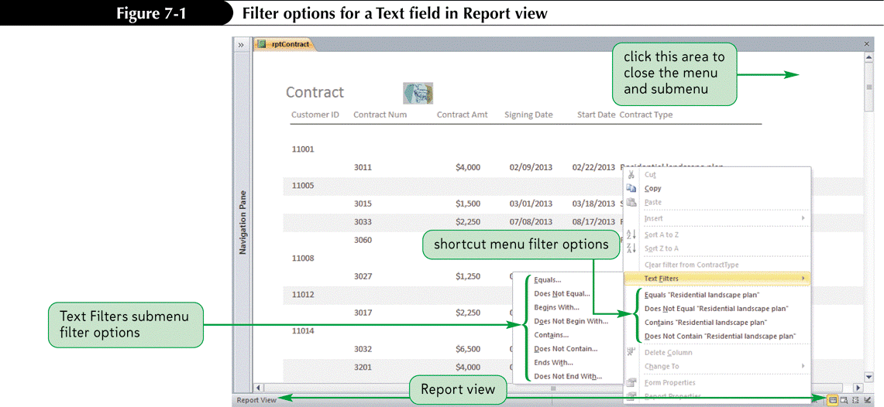
Customizing Existing Reports
Report view provides an interactive view of a report

Slide 6
Customizing Existing Reports

Slide 7
Customizing Existing Reports

Slide 8
Custom Report Design

Slide 9
Designing a Custom Report
Before creating a custom report, first plan the report’s contents and appearance. Also refer to existing documents.
Purpose and record source
Sort order
Grouping fields
Balance attractiveness and readability
Group related fields
Identify field values
Include title, page number, and date on every page
Identify end of report
Use little formatting
Use consistent style

Slide 10
Creating a Query for a Custom Report

Slide 11
Creating a Blank Report in Layout View
Click the Create tab on the Ribbon
In the Reports group on the Create tab, click the Blank Report button to open a blank report in Layout view

Slide 12
Sorting and Grouping Data in a Report
Display the report in Layout or Design view
If necessary, click the Group & Sort button in the Grouping & Totals group on the Design tab to display the Group, Sort, and Total pane
To select a grouping field, click the Add a group button in the Group, Sort, and Total pane, and then click the grouping field in the list. To set additional properties for the grouping field, click the More button on the group field band
To select a sort field that is not a grouping field, click the Add a sort button in the Group, Sort, and Total pane, and then click the sort field in the list. To set additional properties for the sort field, click the More button on the sort field band

Slide 13
Sorting and Grouping Data in a Report

Slide 14
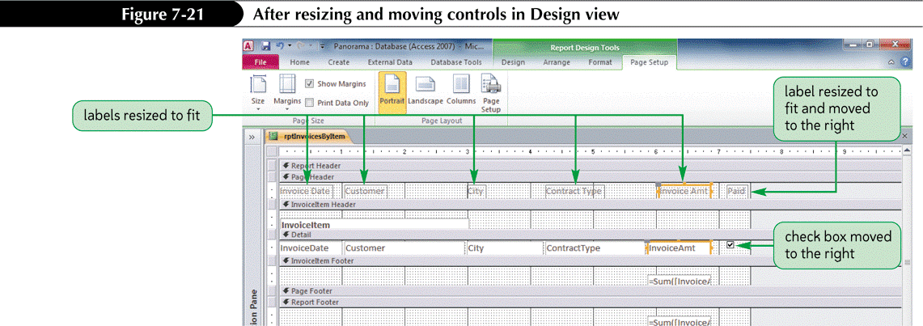
Working with Controls in Design View
Compared to Layout view, Design view provides greater control over the placement and sizing of controls, and allows adding and manipulating many more controls.
Problem- in Design view does not display live data in the controls that can serve as a guide to make changes

Slide 15
Hiding Duplicate Values in a Report
Display the report in Layout or Design view
Open the property sheet for the field whose duplicate values is to be hidden, set the Hide Duplicates property to Yes, and then close the property sheet

Slide 16
Custom Report Design

Slide 17
Adding the Date and Time to a Report
Display the report in Layout or Design view
In the Header/Footer group on the Design tab in Design view or in Layout view, click the Date and Time button to open the Date and Time dialog box
To display the date, click the Include Date check box, and then click one of the three date option buttons
To display the time, click the Include Time check box, and then click one of the three time option buttons
Click the OK button

Slide 18
Adding the Date and Time to a Report

Slide 19
Adding Page Numbers to a Report
Display the report in Layout or Design view
In the Header/Footer group on the Design tab in Design view or in Layout view, click the Page Numbers button to open the Page Numbers dialog box
Select the format, position, and alignment options you want
Select whether to display the page number on the first page
Click the OK button to place the page number expression in the report

Slide 20
Adding Page Numbers to a Report

Slide 21
Adding a Title to a Report

Slide 22
Creating Mailing Labels and Other Labels
In the Navigation Pane, click the table or query that will serve as the labels record source
In the Reports group on the Create tab, click the Labels button to start the Label Wizard and open its first dialog box
Select the label manufacturer and its product number, and then click the Next button
Select the label font, color, and style, and then click the Next button
Construct the label content by selecting the fields from the record source and specifying their placement and spacing on the label, and then click the Next button
Select one or more optional sort fields, click the Next button, specify the report name, and then click the Finish button

Slide 23
Creating Mailing Labels and Other Labels

