Slide 1
Tutorial 8 Sharing, Integrating, and Analyzing Data

Slide 2
Objectives
Export an Access table to an HTML document and view the document
Import a CSV file as an Access table
Use the Table Analyzer
Import and export XML files
Save and run import and export specifications

Slide 3
Objectives
Create a multi-page form using a tab control
Embed a chart in a form
Create and modify PivotTables and PivotCharts
Link data from an Excel worksheet

Slide 4
HTML Source and Web Page

Slide 5
Exporting an Access Query to an HTML Document
In the Navigation Pane, right-click the object (table, query, form, or report) to be exported, point to Export on the shortcut menu, and then click HTML Document
or
In the Navigation Pane, click the object (table, query, form, or report) to be exported, click the External Data tab on the Ribbon, click the More button in the Export group on the External Data tab, and then click HTML Document
Click the Browse button in the Export – HTML Document dialog box, select the location to save the file, enter the filename in the File name box, and then click the Save button

Slide 6
Exporting an Access Query to an HTML Document
Click the Export data with formatting and layout check box to retain most formatting and layout information, and then click the OK button
If using a template, click the Select a HTML Template check box in the HTML Output Options dialog box, click the Browse button, select the location for the template, click the template filename, and then click the OK button
Click the OK button

Slide 7
Viewing an HTML Document Using Internet Explorer
Open Windows Explorer, and then navigate to and open the Access2\Tutorial folder, which is where the exported HTML document was saved
Right-click Crosstab in the file list to open the shortcut menu, click Open with, click Internet Explorer, and then click the OK button (if necessary)

Slide 8
Importing a CSV File as an Access Table
In the Import & Link group on the External Data tab on the Ribbon, click the Text File button to open the Get External Data - Text File dialog box
Click the Browse button in the dialog box, navigate to the location where the file to import is stored, click the filename, and then click the Open button
Click the Import the source data into a new table in the current database option button, and then click the OK button
In the Import Text Wizard dialog box, click the Delimited option button, and then click the Next button

Slide 9
Importing a CSV File as an Access Table
Make sure the Comma option button is selected. If appropriate, click the First Row Contains Field Names check box to select it, and then click the Next button
For each field, if necessary, select the column, type its field name and select its data type, and then click the Next button
Choose the appropriate option button- let Access create a primary key, choose a primary key, or to avoid setting a primary key; click the Next button, type the table name in the Import to Table box, and then click the Finish button

Slide 10
Importing a CSV File as an Access Table

Slide 11
Importing a CSV File as an Access Table

Slide 12
Importing an XML File as an Access Table
In the Import & Link group on the External Data tab on the Ribbon, click the XML File button to open the Get External Data - XML File dialog box
Click the Browse button, navigate to the location for the XML file, click the XML filename, and then click the Open button
Click the OK button in the Get External Data - XML File dialog box, click the table name in the Import XML dialog box, click the appropriate option button in the Import Options section, and then click the OK button
Click the Close button

Slide 13
Importing an XML File as an Access Table
or
To save the import steps, click the Save import steps check box, enter a name for the saved steps in the Save as box, and then click the Save Import button

Slide 14
Importing an XML File as an Access Table

Slide 15
Exporting an Access Object as an XML File
Right-click the object (table, query, form, or report) in the Navigation Pane, point to Export, and then click XML File
or
Click the object (table, query, form, or report) in the Navigation Pane. In the Export group on the External Data tab, click XML File button
Click the Browse button in the Export - XML File dialog box, navigate to the location where you will save the XML file, and then click the Save button

Slide 16
Exporting an Access Object as an XML File
Click the OK button in the dialog box, select the options in the Export XML dialog box or click the More Options button and select the options in the expanded Export XML dialog box, and then click the OK button
Click the Close button
or
To save the export steps, click the Save export steps check box, enter a name for the saved steps in the Save as box, and then click the Save Export button

Slide 17
Exporting an Access Table as an XML File

Slide 18
Filtered PivotChart

Slide 19
Creating a Multi-page Form Using a Tab Control
Create a multi-page form two ways:
Page Break tool
Tab Control tool

Slide 20
Integrating Access with Other Programs
When integrating information between programs, the program containing the original information, or object, is called the source program, and the program in which is placed the information created by the source program is called the destination program
Importing
Embedding
Linking

Slide 21
Embedding a Chart in a Form or Report
In the Controls group on the Design tab in Design view, click the More button, and then click the Chart tool
Position the + portion of the pointer where you want to position the upper-left corner of the chart, and then click the mouse button to start the Chart Wizard
Select the record source, fields, and chart type
Edit the chart contents, and select the fields that link the object and chart, if necessary
Enter a chart title, select whether to include a legend, and then click the Finish button

Slide 22
Embedding a Chart in a Form or Report

Slide 23
Creating and Using a PivotTable
PivotTable- an interactive table to dynamically analyze data
Total/Detail area
Detail field
Detail values
Row area
Row field
Row field items
Column area
Column Field
Column field items
Filter area
Filter field
Filter field items

Slide 24
Creating and Using a PivotTable

Slide 25
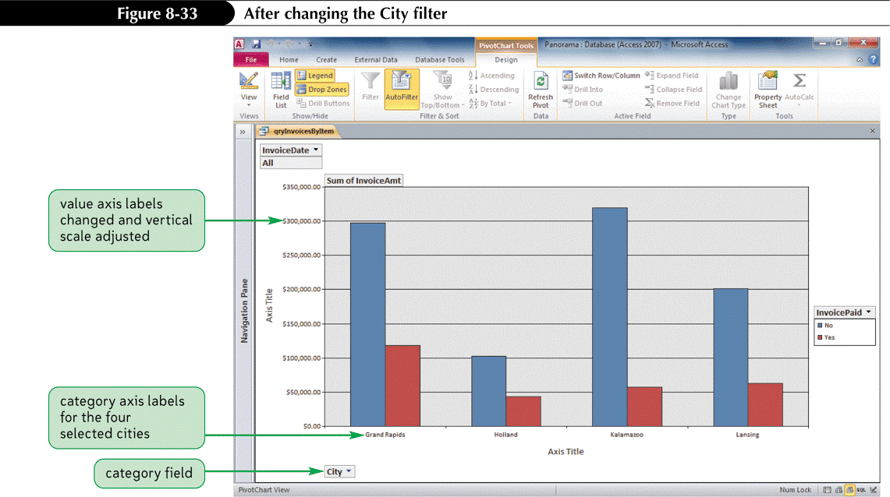
Creating a PivotChart
Office provides the Office PivotChart Component to assist in adding a chart to a table or query

Slide 26
Linking Data from an Excel Worksheet
Click the External Data tab on the Ribbon, and then in the Import & Link group on the External Data tab, click the Excel button
Click the Browse button and select the file to import
Follow the steps in the dialog boxes

Slide 27
Linking Data from an Excel Worksheet

Slide 28
Linking Data from an Excel Worksheet

