Slide 1
Tutorial 9 Using Action Queries and Advanced Table Relationships

Slide 2
Objectives
Create an action query to create a table
Create action queries to append, delete, and update data
Define many-to-many and one-to-one relationships between tables
Learn about joining tables
Join a table using a self-join
View and create indexes for tables

Slide 3
Action Queries

Slide 4
Action Queries
An action query is a query that adds, changes, or deletes multiple table records at a time
BE CAREFUL!
Make-table query
Append query
History table
Delete query
Update query

Slide 5
Creating a Make-Table Query
Create a select query with the necessary fields and selection criteria
In the Results group on the Design tab, click the Run button to preview the results
Switch to Design view to make any necessary changes to the query. When the query is correct, click the Make Table button in the Query Type group on the Design tab

Slide 6
Creating a Make-Table Query
In the Make Table dialog box, type the new table name in the Table Name box. Make sure the Current Database option button is selected to include the new table in the current database; or, click the Another Database option button and enter the database name in the File Name box. Then click the OK button
Click the Run button, and then click the Yes button to confirm the creation of the new table

Slide 7
Creating a Make-Table Query

Slide 8
Creating an Append Query
Create a select query with the necessary fields and selection criteria
In the Results group on the Design tab, click the Run button to preview the results
Switch to Design view to make any necessary changes to the query. When the query is correct, click the Append button in the Query Type group on the Design tab

Slide 9
Creating an Append Query
In the Append dialog box, select the table name in the Table Name box. Make sure the Current Database option button is selected to include the new table in the current database; or, click the Another Database option button and enter the database name in the File Name box. Then click the OK button. Access replaces the Show row in the design grid with the Append To row
Click the Run button, and then click the Yes button to confirm appending the records to the table

Slide 10
Creating an Append Query

Slide 11
Creating a Delete Query
Create a select query with the necessary fields and selection criteria
In the Results group on the Design tab, click the Run button to preview the results
Switch to Design view to make any necessary changes to the query. When the query is correct, click the Delete button in the Query Type group on the Design tab. Access replaces the Show and Sort rows in the design grid with the Delete row
Click the Run button, and then click the Yes button to confirm deleting the records

Slide 12
Creating a Delete Query

Slide 13
Creating an Update Query
Create a select query with the necessary fields and selection criteria
In the Results group on the Design tab, click the Run button to preview the results
Switch to Design view to make any necessary changes to the query. When the query is correct, click the Update button in the Query Type group on the Design tab. Access replaces the Show and Sort rows in the design grid with the Update To row

Slide 14
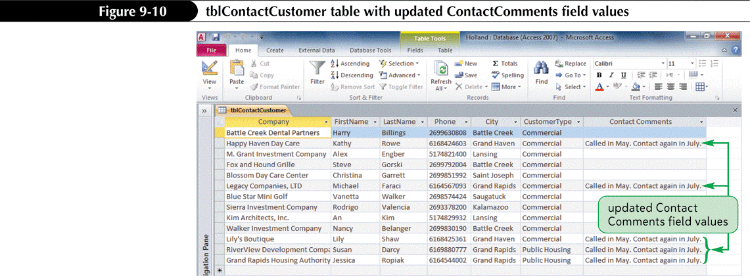
Creating an Update Query
Type the updated values in the Update To boxes for the fields you want to update
Click the Run button, and then click the Yes button to confirm changing the records

Slide 15
Many-To-Many Relationship

Slide 16
Relationships Between Database Tables

Slide 17
Relationships Between Database Tables

Slide 18
Defining M:N and 1:1 Relationships Between Tables

Slide 19
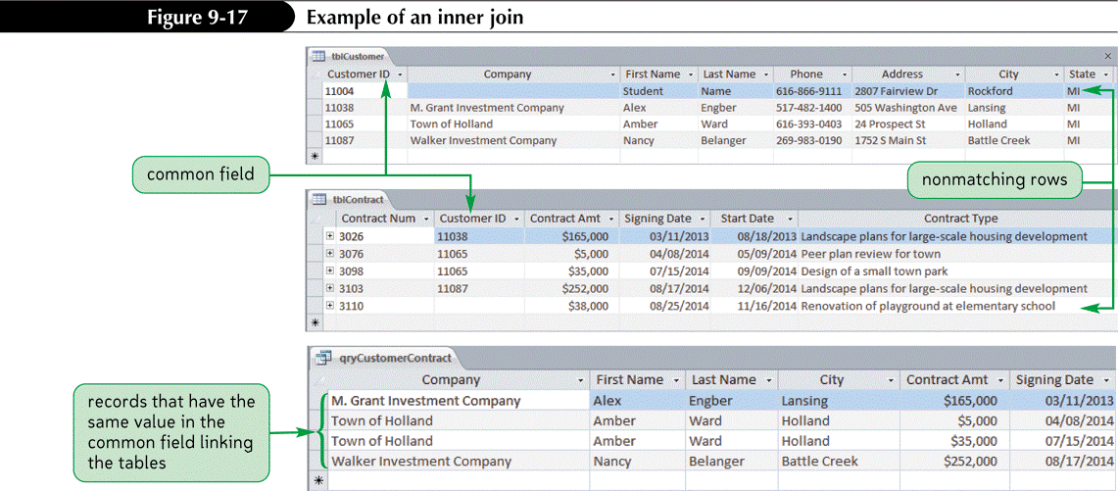
Joining Tables
An inner join is a join in which the DBMS selects records from two tables only when the records have the same value in the common field that links the tables

Slide 20
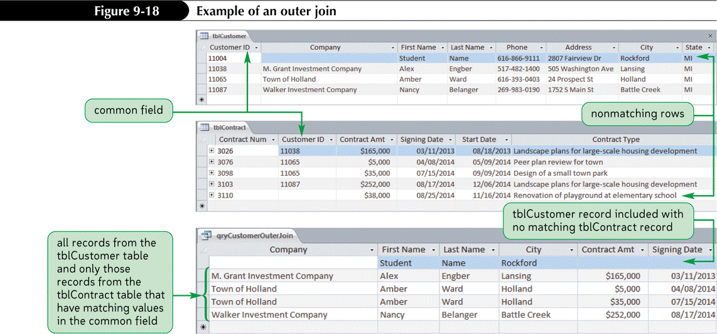
Joining Tables
An outer join is a join in which the DBMS selects all records from one table and only those records from a second table that have matching common field values

Slide 21
Creating a Self-Join
Click the Create tab on the Ribbon
In the Queries group on the Create tab, click the Query Design button
In the Show Table dialog box, double-click the table for the self-join, double-click the table a second time, and then click the Close button
Click and drag the primary key field from one field list to the foreign key field in the other field list

Slide 22
Creating a Self-Join
Right-click the join line between the two tables, and then click Join Properties to open the Join Properties dialog box
Click the first option button to select an inner join, or click the second option button or the third option button to select an outer join, and then click the OK button
Select the fields, specify the selection criteria, select the sort options, and set other properties as appropriate for the query

Slide 23
Creating a Self-Join

Slide 24
Viewing a Table’s Existing Indexes
Open the table in Design view
To view an index for a single field, click the field, and then view the Indexed property in the Field Properties pane
To view all the indexes for a table or to view an index consisting of multiple fields, click the Indexes button in the Show/Hide group on the Design tab

Slide 25
Viewing a Table’s Existing Indexes

Slide 26
Creating an Index
Open the table in Design view
To create an index for a single field, click the field, and then set the Indexed property in the Field Properties pane
To create an index consisting of multiple fields, click the Indexes button in the Show/Hide group on the Design tab, enter a name for the index in the Index Name box, select the fields in the Field Name box, and then set other properties as necessary for the index

Slide 27
Creating an Index

