Slide 1
Tutorial 10 Automating Tasks with Macros

Slide 2
Objectives
Run and add actions to macros
Single step a macro
Create a submacro
Add a command button to a form
Attach a macro to a command button

Slide 3
Objectives
Create an unbound form
Add a list box to a form
Use an SQL statement to fill a list box with object names
Create multiple macros on a form
Create a navigation form

Slide 4
Macro Designer

Slide 5
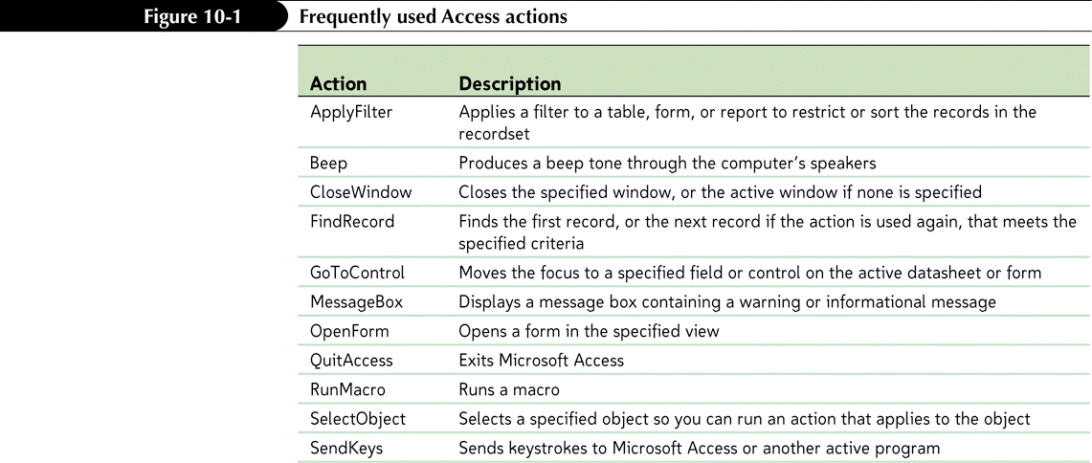
Introduction to Macros
A macro is an action, or a set of actions, that Access will perform automatically when run

Slide 6
Directly Running an Existing Macro
With the Macro Designer open, click the Run button in the Tools group on the Design tab on the Ribbon
or
In the Macro group on the Database Tools tab on the Ribbon, click the Run Macro button, select the macro name in the Macro Name list in the Run Macro dialog box, and then click the OK button
or
In the Macros group in the Navigation Pane, right-click the macro name, and then click Run on the shortcut menu

Slide 7
Directly Running an Existing Macro

Slide 8
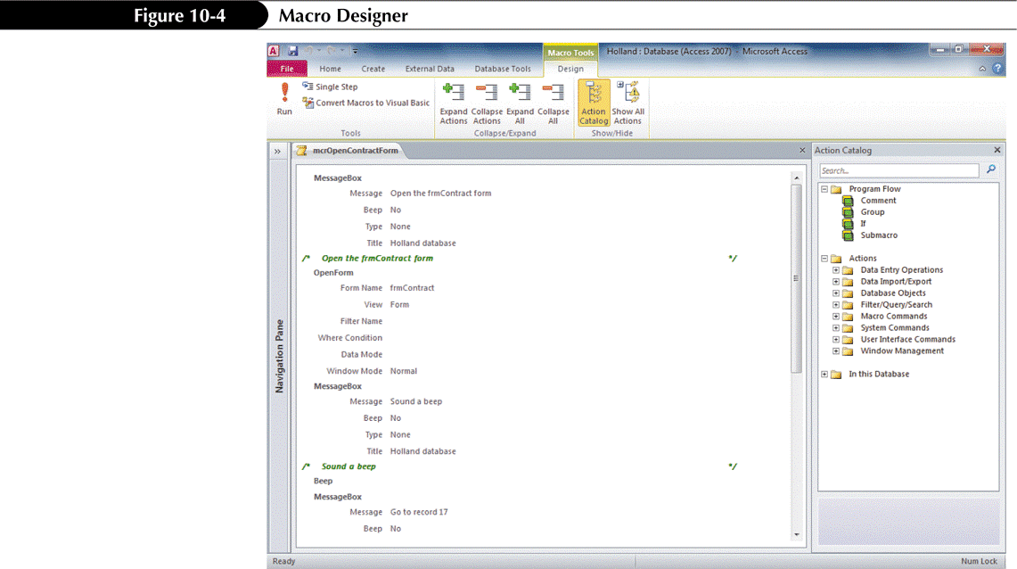
Adding Actions to a Macro
The Macro Designer creates and modifies macros

Slide 9
Single Stepping a Macro
The macro single step feature executes a macro one action at a time, pausing between actions
In the Macro Designer, click the Single Step button in the Tools group on the Design tab
Click the Run button in the Tools group on the Design tab
In the Macro Single Step dialog box, click the Step button to execute the next action, click the Stop All Macros button to stop the macro, or click the Continue button to execute all remaining actions in the macro and turn off the single step process

Slide 10
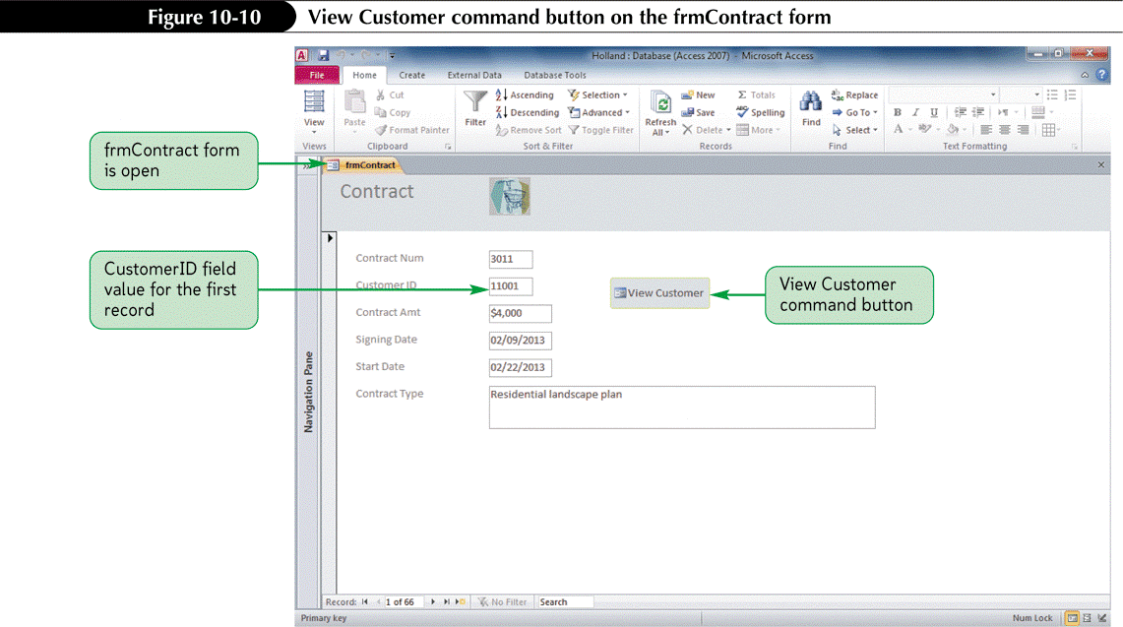
Using a Command Button with an Attached Macro
A command button is a control on a form that starts an action, or a set of actions, when clicked

Slide 11
Submacros
A submacro is a complete macro with a Submacro header within a macro

Slide 12
Adding a Submacro
Open the macro in the Macro Designer
Click the Add New Action arrow, click Submacro, and then type the submacro name in the Submacro box
Click the Add New Action arrow above the End Submacro statement, click the action to use, then set the action’s arguments
If the submacro consists of more than one action, repeat the previous step for each action
Add comments as needed to the submacro to document the submacro’s function or provide other information
Save the macro

Slide 13
Adding a Command Button to a Form

Slide 14
Attaching a Submacro to a Command Button

Slide 15
Navigation Form

Slide 16
Designing a User Interface
A user interface is the visual display of controls and objects to communicate with a computer program

Slide 17
Adding a List Box to a Form
Switch to Design view, if necessary
If necessary, click the More button in the Controls group on the Design tab, and then click the Use Control Wizards tool to select or deselect it
Click the More button in the Controls group on the Design tab, and then click the List Box tool

Slide 18
Adding a List Box to a Form
Position the pointer’s plus symbol (+) where you want to place the upper-left corner of the list box, and then click the mouse button
If the List Box Wizard is used, complete the dialog boxes to choose the source of the list, select the fields to appear in the list box, select a sort order, size the columns, and select the label
If the List Box Wizard is not used, set the Row Source property and size the list box

Slide 19
Adding a List Box to a Form

Slide 20
Using SQL
SQL (Structured Query Language) is a standard language used in querying, updating, and managing relational databases
Open the query in Datasheet view or Design view
Click the SQL View button on the status bar, right-click the object tab and click SQL View on the shortcut menu, or click the View button arrow in the Views group (in Datasheet view) or in the Results group (in Design view) and click SQL View

Slide 21
Using SQL
Using SQL view is a great way to learn to create SQL statements

Slide 22
Macros
The Load event occurs when Access opens a form

Slide 23
Creating a Navigation Form
A navigation form is a form with tabs that allows you to display database objects in an organized way to users

