Slide 1
Tutorial 11 Using and Writing Visual Basic for Applications Code

Slide 2
Objectives
Learn about Function procedures (functions), Sub procedures (subroutines), and modules
Review and modify an existing subroutine in an event procedure
Create a function in a standard module
Test a procedure in the immediate window
Create event procedures
Compile and test functions, subroutines, and event procedures
Hide text and change display colors

Slide 3
VBA Code Window

Slide 4
Introduction to Visual Basic for Applications
Visual Basic for Applications (VBA) is the programming language provided with Access and other Office programs
VBA has a common syntax and a set of common features for all Microsoft Office programs
Event-driven language
Object-oriented language

Slide 5
Events

Slide 6
Procedures
A Function procedure, or function, performs operations, returns a value, accepts input values, and can be used in expressions (recall that an expression is a calculation resulting in a single value)
A Sub procedure, or subroutine, performs operations and accepts input values, but does not return a value and cannot be used in expressions

Slide 7
Modules

Slide 8
Modules
Declarations section
Standard module
Public procedure
Class module
Local procedure
Private procedure

Slide 9
Using an Existing Procedure

Slide 10
Creating a New Standard Module
Click the Create tab on the Ribbon
In the Macros & Code group on the Create tab, click the Module button. A new Code window opens in the Visual Basic window

Slide 11
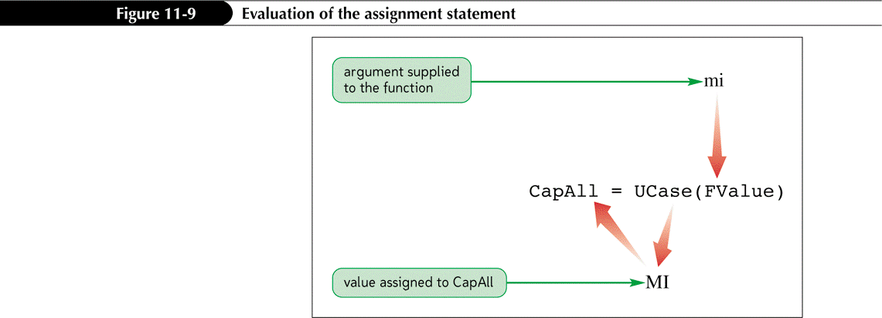
Creating a Function
Each function begins with a Function statement and ends with an End Function statement
Parameter
Argument

Slide 12
Testing a Procedure in the Immediate Window
In the Code window, click View on the menu bar, and then click Immediate Window to open the Immediate window
Type a question mark (?), the procedure name, and the procedure’s arguments in parentheses. If the argument contains a string of characters, enclose the argument in quotation marks
Press the Enter key and verify the displayed answer

Slide 13
Testing a Procedure in the Immediate Window

Slide 14
Event Procedure

Slide 15
Creating an Event Procedure

Slide 16
Designing the Event Procedure

Slide 17
Adding an Event Procedure to a Form or Report
Open the form or report in Design view, select the control to set the event property, open the property sheet for the control, and then click the Event tab in the property sheet
Click the event property box, click its Build button, click Code Builder in the Choose Builder dialog box, and then click the OK button
Enter the subroutine statements in the Code window
Compile the procedure, fix any statement errors, and then save the event procedure

Slide 18
Adding an Event Procedure to a Form or Report

Slide 19
Compiling Modules
The process of translating modules from VBA to a form your computer understands is called compilation; compile is the term used
To run a procedure for the first time, Access automatically compiles it and opens a dialog box only when it finds syntax errors in the procedure

Slide 20
Adding a Second Procedure to a Class Module

Slide 21
Adding a Second Procedure to a Class Module

Slide 22
Changing the Case of a Field Value
StrConv function
wvProperCase constant
vbUpperCase constant
vbLowerCase constant

Slide 23
Hiding Controls and Changing a Control’s Color

Slide 24
Hiding Controls and Changing a Control’s Color

