Slide 1
Tutorial 12
Managing and Securing a Database

Slide 2
Objectives
Filter data in a table and a form
Save a filter as a query and apply the saved query as a filter
Create a subquery
Create a multivalued field
Create an Attachment field
Use an AutoNumber field
Save a database as a previous version

Slide 3
Objectives
Analyze a database’s performance
Link a database to a table in another database
Use the Linked Table Manager
Split a database
Encrypt a database with a password
Set database properties and startup options
Create an ACCDE file

Slide 4
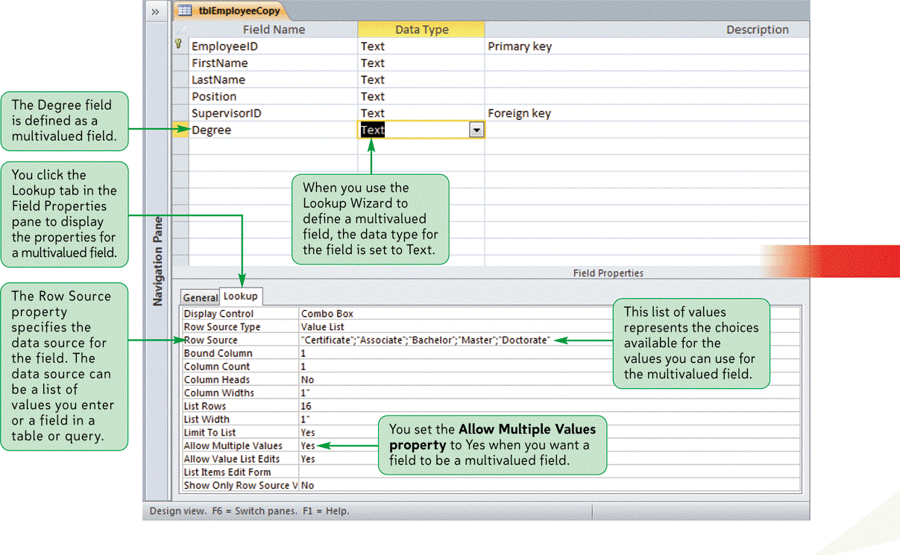
Multivalued Fields

Slide 5
Selecting Records Using Filter By Form
Open the table or query datasheet, or the form in Form view
In the Sort & Filter group on the Home tab, click the Advanced button, and then click Filter By Form
Enter a simple selection criterion or an And condition in the first datasheet or form, using the text boxes for the appropriate fields

Slide 6
Selecting Records Using Filter By Form
If there is an Or condition, click the Or tab and enter the Or condition in the second datasheet or form. Continue to enter Or conditions on separate datasheets or forms by using the Or tab
In the Sort & Filter group on the Home tab, click the Toggle Filter button (with the ScreenTip “Apply Filter”)

Slide 7
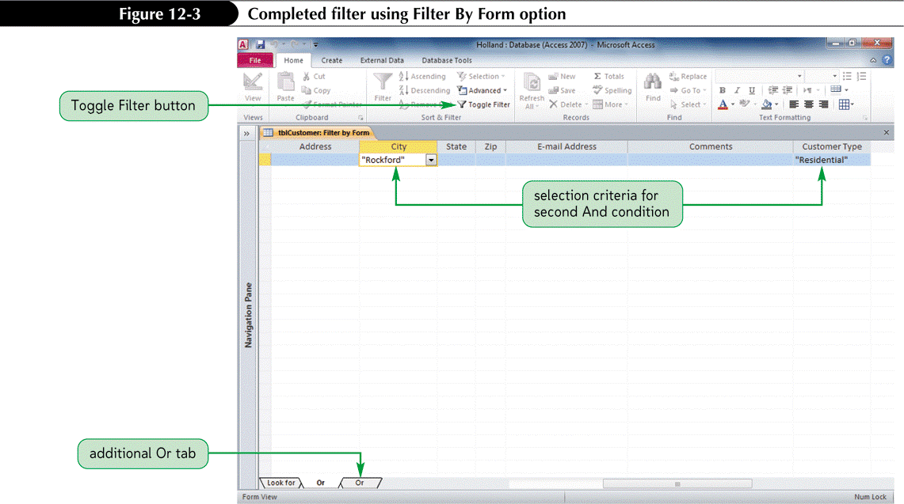
Selecting Records Using Filter By Form

Slide 8
Saving a Filter as a Query
Create a filter using Filter By Selection, Filter By Form, or Advanced Filter/Sort
If filter was applied by using Filter By Form, click the Advanced button, and then click Filter By Form
In the Sort & Filter group on the Home tab, click the Advanced button, and then click Save As Query
Type the name for the query, and then press the Enter key

Slide 9
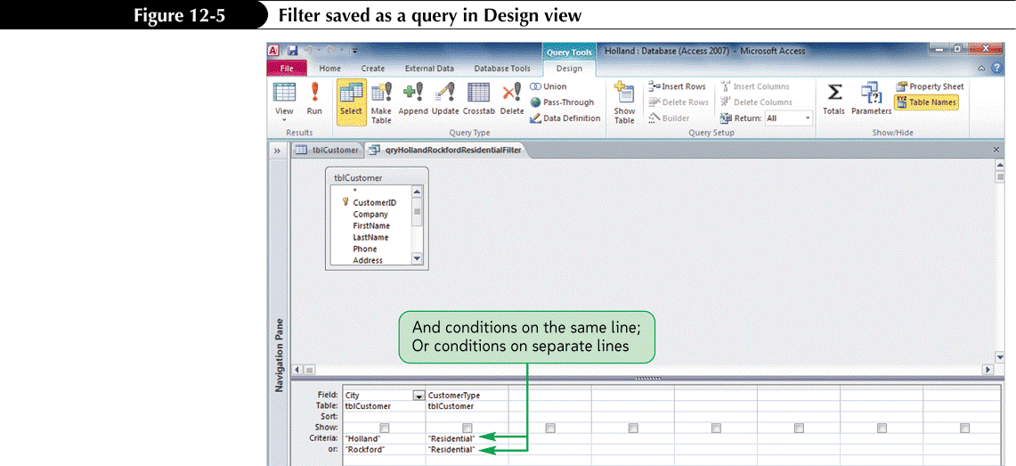
Saving a Filter as a Query

Slide 10
Applying a Filter Saved as a Query
Open the table in Datasheet view
In the Sort & Filter group on the Home tab, click the Advanced button, and then click Filter By Form
In the Sort & Filter group, click the Advanced button, and then click Load from Query
In the Applicable Filter dialog box, click the query to apply as a filter, and then click the OK button
In the Sort & Filter group on the Home tab, click the Toggle Filter button (with the ScreenTip “Apply Filter”) to apply the filter

Slide 11
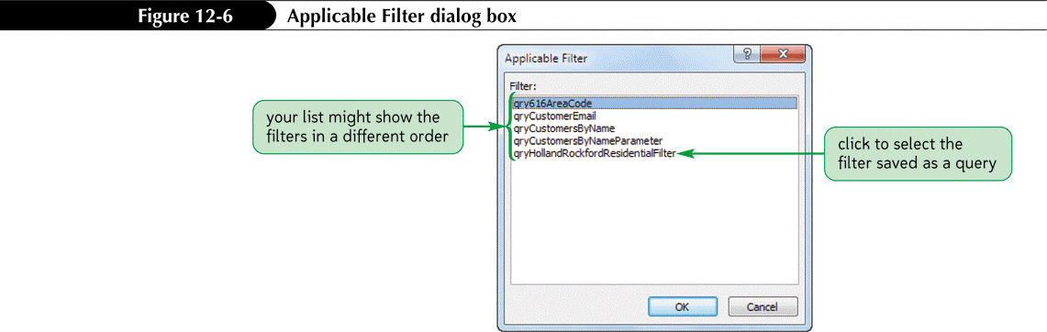
Applying a Filter Saved as a Query

Slide 12

Creating a Subquery

Slide 13
Using Multivalued Fields
A multivalued field is a lookup field that allows storage of more than one value

Slide 14
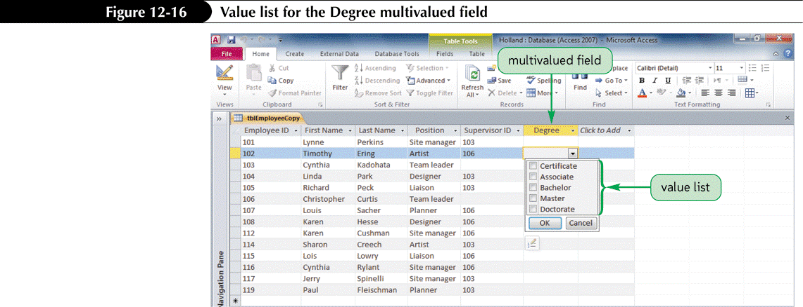
Using Multivalued Fields

Slide 15
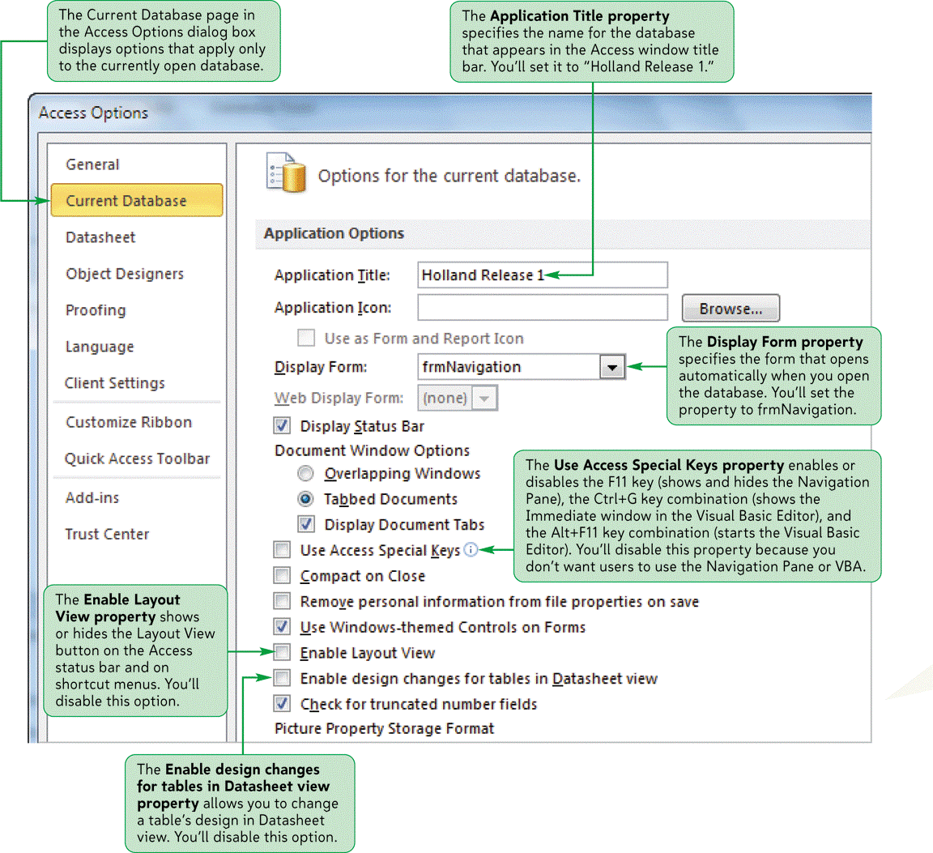
Database Properties

Slide 16
Creating an Attachment Field
Use the Attachment data type to attach one or more attachments to a table record
  Access stores attachments in compressed form to minimize file size and maximize disk space usage

Slide 17
Using an AutoNumber Field
A table created in Datasheet view is assigned the AutoNumber data type in the default ID primary key field because the AutoNumber data type automatically inserts a unique number in this field for every record in the table

Slide 18
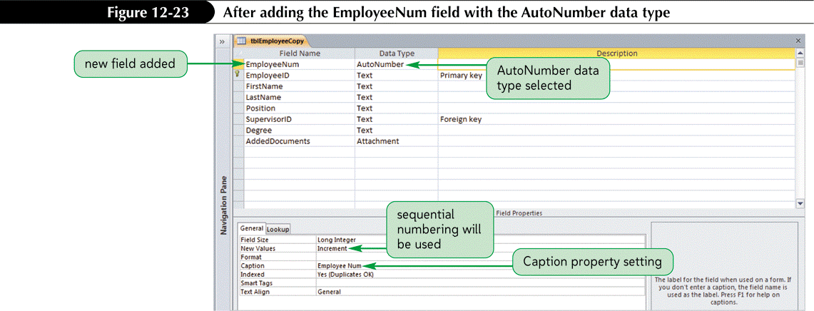
Using an AutoNumber Field

Slide 19
Saving an Access Database as a Previous Version
Make sure that the database is open and all database objects are closed, and that the database does not contain any features included only in Access 2007 file-formatted databases
Click the File tab on the Ribbon to display Backstage view, click Save & Publish in the navigation bar, click Save Database As, and then click Access 2002-2003 Database or click Access 2000 Database, depending on the desired file format

Slide 20
Saving an Access Database as a Previous Version
Click the Save As button. In the Save As dialog box, navigate to the folder to save the file, enter a name for the database in the File name box, and then click the Save button

Slide 21
Using the Performance Analyzer
Start Access and open the database to be analyzed
In the Analyze group on the Database Tools tab on the Ribbon, click the Analyze Performance button
Select the object(s) to analyze, and then click the OK button

Slide 22
Using the Performance Analyzer
Select the analysis result(s) to be completed, and then click the Optimize button
Note the idea optimizations and perform those optimizations, as appropriate
Click the Close button

Slide 23
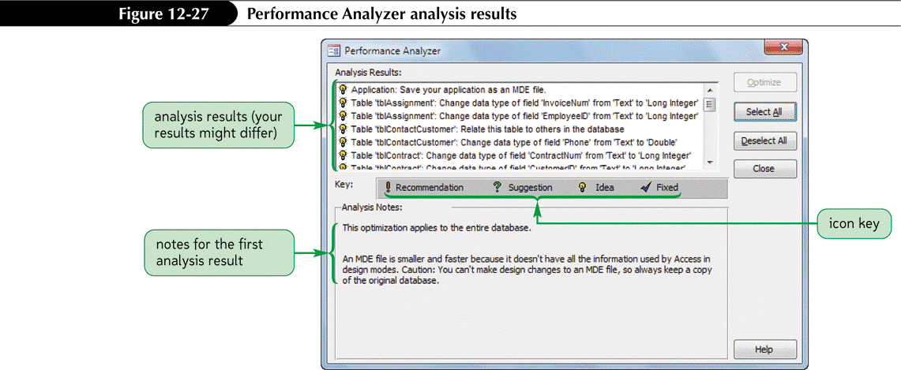
Using the Performance Analyzer

Slide 24
Linking to a Table in Another Access Database
Click the External Data tab on the Ribbon
In the Import & Link group on the External Data tab, click the Access button (with the ScreenTip “Import Access database”)
Click the Link to the data source by creating a linked table option button
Click the Browse button, select the folder and file containing the linked data, and then click the Open button
Click the OK button, select the table(s) in the Link Tables dialog box, and then click the OK button

Slide 25
Using the Linked Table Manager
In the Navigation Pane, right-click the linked table name, and then click Linked Table Manager on the shortcut menu
or
In the Import & Link group on the External Data tab, click the Linked Table Manager button

Slide 26
Using the Linked Table Manager
Click the check box(es) to select the linked table(s)to refresh, and then click the OK button
Navigate to the linked table location, click the filename, and then click the Open button.
Click the OK button, and then close the Linked Table Manager dialog box

Slide 27
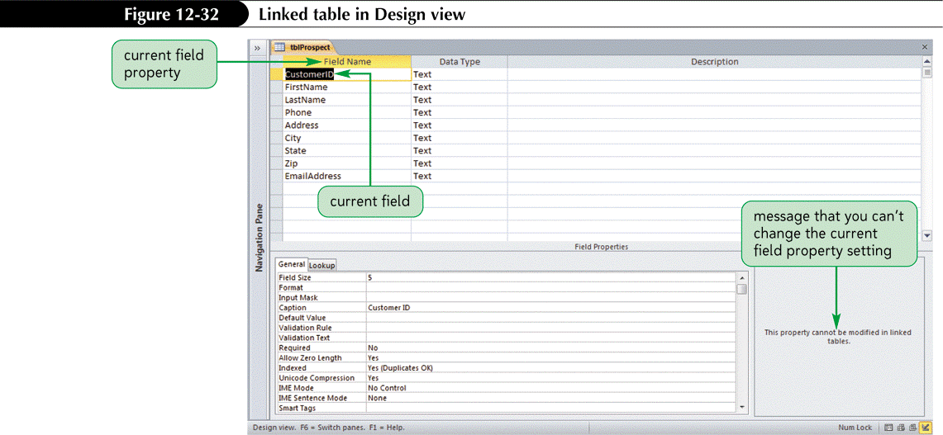
Using the Linked Table Manager

Slide 28
Using the Database Splitter
The Database Splitter is an Access tool that splits an Access database into two files: one file contains the tables, and the other file contains the queries, forms, reports, and other database objects

Slide 29
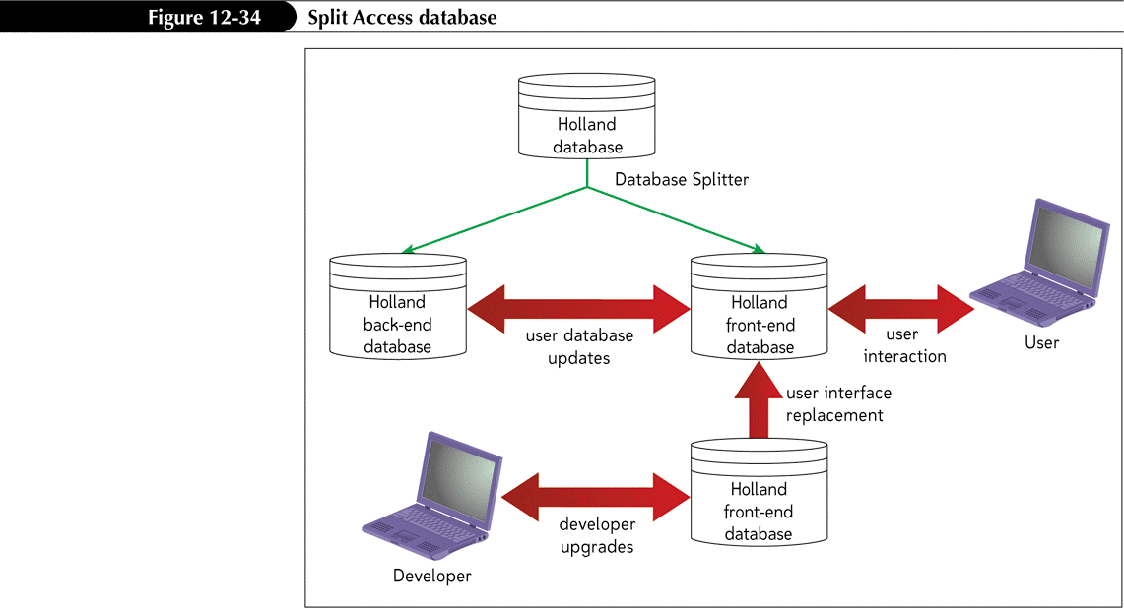
Using the Database Splitter

Slide 30
Using the Database Splitter
Make a backup copy of the database to be split
Start Access and open the database
Click the Database Tools tab on the Ribbon, and then in the Move Data group, click the Access Database button
Click the Split Database button, select the drive and folder for the back-end database, type a name for the database in the File name box, and then click the Split button
Click the OK button

Slide 31
Encrypting a Database and Setting a Password
Start Access, click the File tab on the Ribbon, and then click Open in the navigation bar
Select the drive and folder that contains the database, and then click the database name
Click the Open button arrow, and then click Open Exclusive
Click the File tab, and then click the Encrypt with Password button
Type the password in the Password box, type the same password in the Verify box, press the Enter key, and then click the OK button in the message box

Slide 32
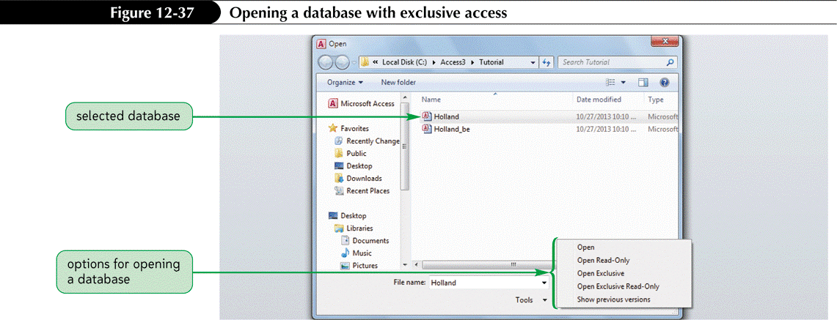
Encrypting a Database and Setting a Password

Slide 33
Unsetting a Database Password
Start Access, click the File tab on the Ribbon, and then click Open in the navigation bar
Select the drive and folder that contains the database, and then click the database name
Click the Open button arrow, and then click Open Exclusive
Click the File tab, and then click the Decrypt Database button
Type the password in the Password box, and then press the Enter key

Slide 34

Unsetting a Database Password

Slide 35
Setting the Database Properties and Startup Options
Open the database, click the File tab, and then click Options in the navigation bar
In the Access Options dialog box, click Current Database in the left section
Set the database properties and startup options, and then click the OK button. Most options will take effect the next time the database is opened

Slide 36
Setting Database Documentation Properties
Open the database, click the File tab, and then click the View and edit database properties link in the right section of the window
Click the Custom tab
To set an existing property, scroll the Name list, click the property in the Name list, type the property setting in the Value box, and then click the Add button
To create a new property, type the property name in the Name box, select the data type in the Type box, type the property value in the Value box, and then click the Add button
Click the OK button

Slide 37
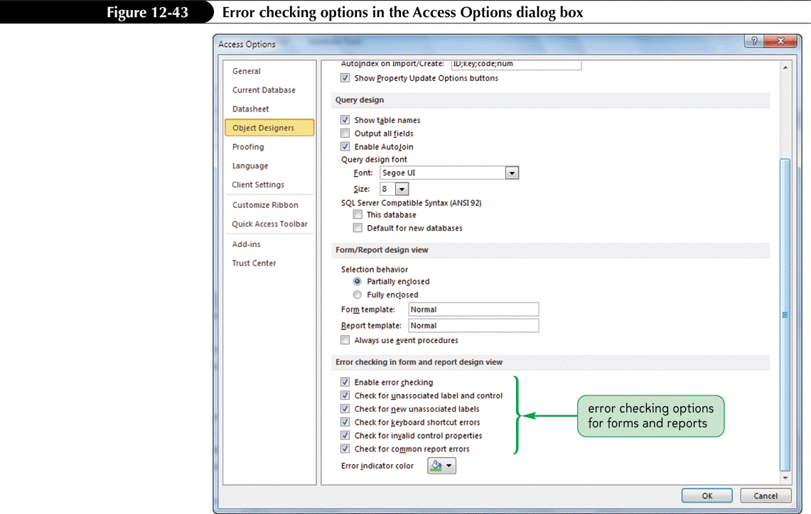
Setting Database Documentation Properties

Slide 38
Saving a Database as an Executable, Protected ACCDE File
Open the database to be saved as an ACCDE file
Click the File tab on the Ribbon, click Save & Publish in the navigation bar, and then click Make ACCDE
Click the Save As button. In the Save As dialog box, type the name for the file in the File name box, navigate to the location to store the file, and then click the Save button
Ref: https://www.lifewire.com/accde-file-2619461 and
https://support.office.com/en-us/article/Hide-VBA-code-from-users-ce6ab610-af07-4008-91e0-1ef1b796ff18#bm1

